Slide 1
BioEthics
Biotechnology with a conscience

Slide 2
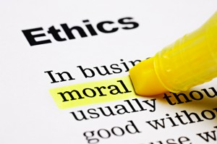
Moral Standards
Being able to distinguish between right and wrong and to make decisions based on that knowledge is considered “having Good Morals”

Slide 3
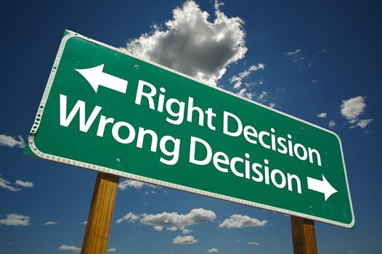
Moral Standards
Because there are some differences in people’s beliefs of right and wrong, some people have different morals than others

Slide 4
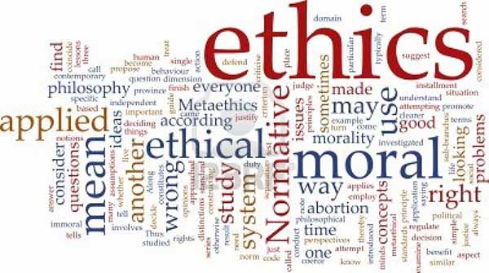
Ethics
Ethics is the study of moral standards and how they affect conduct.

Slide 5
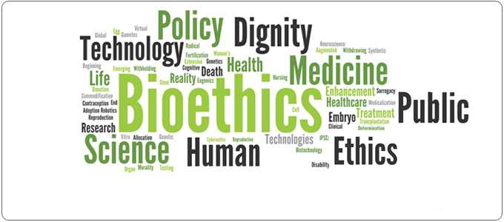
bioethics
Bioethics is a term that has been coined to describe the study of decision-making as it applies to moral decisions that need to be made because of advances in biology, medicine, and technology.

Slide 6
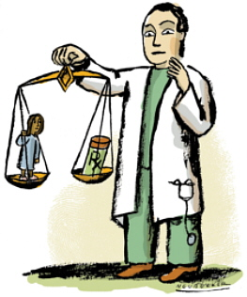
Bioethics
Many of the new biotechnologies are controversial because they force people to think about what they believe is right or wrong.
  Harvesting embryonic stem cells
  Genetically modifying foods
  Testing for Genetic diseases or conditions

Slide 7
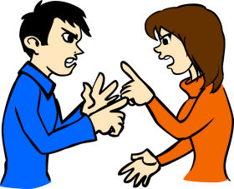
Biotechnology Controversies
Many People have strong feelings about these and other issues
They take personal or public positions to support or oppose these technologies
New technologies generate ethical questions that cannot be answered using scientific methodologies

Slide 8

Positions on Ethical Issues
The position one takes on ethical issued are based on personal feelings and beliefs.
A person can learn more about a technology, but determining whether it is moral to use it is not an objective decision with a clear right or wrong answer but more of a wide range of arguable positions.

Slide 9

Who decides what is right and what is wrong?
Who decides what is acceptable in research and development?
Who decides which testing or products should be allowed and under what circumstances
Who makes public policy for scientific procedure, information, and new technologies?

Slide 10
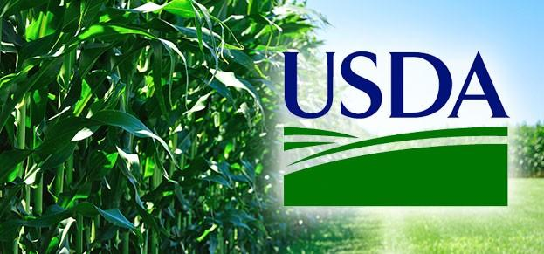
Regulators
USDA-(United States Department of Agrigulture)- regulates the use and production of plants, plant products, plant pests, veterinary supplies, medications, and genetically Modified plants and aminals

Slide 11

Regulators
EPA (Environmental Protection Agency)-regulates the use and production of microbial agents, such as bacteria, fungi, plant pesticides, new uses of existing pesticides, and genetically modified microorganisms.

Slide 12

Regulators
FDA (Food and Drug Administration)-regulates the use and production of food, feed, food additives, veterinary drugs, human drugs, and medical devices

Slide 13

Regulators
Each agencies set policy based on scientific facts that are viewed in conjunction with society’s collective Ethic positions.

Slide 14
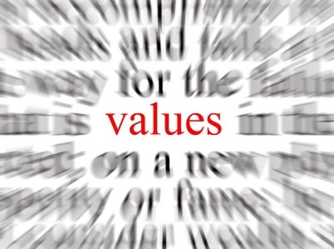
Strategy for values clarification
Strategy for examining bioethical issues is to clarify one’s values through these steps
  Identify and understand the problem or issue, learn about it
  List all possible solutions to the issue
  Identify pros and cons of adopting each solution
  Examine consequences
  Decide if problem is important enough to take a position and be able to defend your position

Slide 15

Examining Solution
Sometimes a problem is complicated enough that is requires writing down all solutions
  Pros and cons
  considerations
After examine these, and individual should be able to form a position on an issue and be able to justify it

