Slide 1
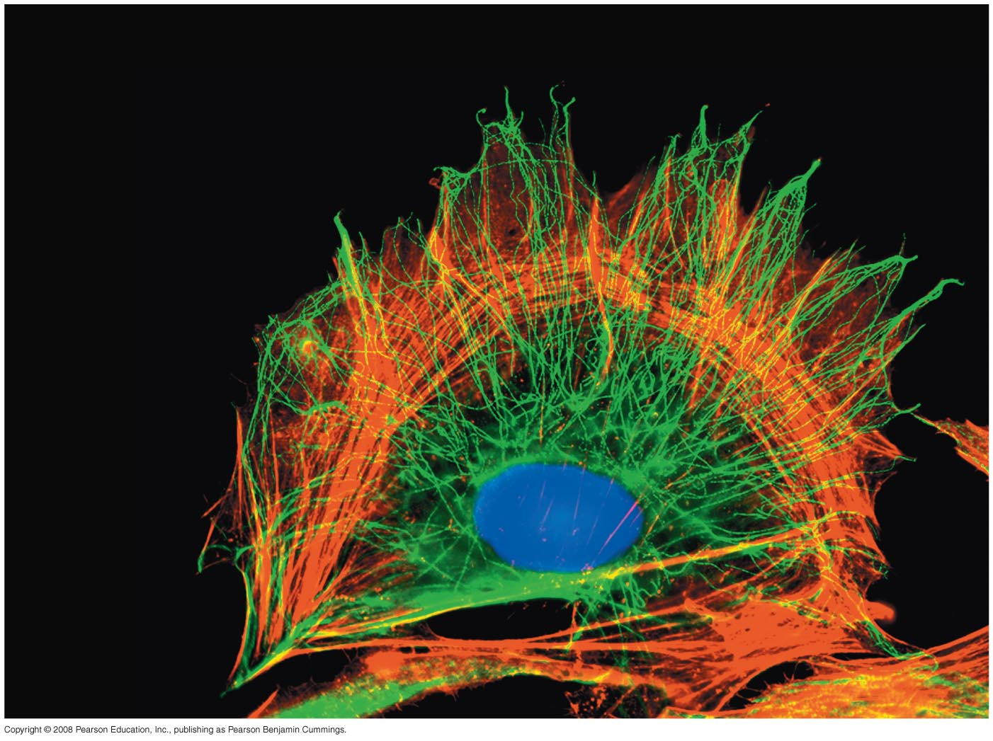
Cells Unit
A Tour of the Cell

Slide 2
Overview: The Fundamental Units of Life
All organisms are made of cells
The cell is the simplest collection of matter that can live
Cell structure is correlated to cellular function
All cells are related by their descent from earlier cells
Copyright © 2008 Pearson Education, Inc., publishing as Pearson Benjamin Cummings
Notes:
For the Discovery Video Cells, go to Animation and Video Files.

Slide 3
Fig. 6-1
Notes:
Figure 6.1 How do cellular components cooperate to help the cell function?

Slide 4
Concept 6.1: To study cells, biologists use microscopes and the tools of biochemistry
Though usually too small to be seen by the unaided eye, cells can be complex
Copyright © 2008 Pearson Education, Inc., publishing as Pearson Benjamin Cummings

Slide 5
Microscopy
Scientists use microscopes to visualize cells too small to see with the naked eye
In a light microscope (LM), visible light passes through a specimen and then through glass lenses, which magnify the image
Copyright © 2008 Pearson Education, Inc., publishing as Pearson Benjamin Cummings

Slide 6
The quality of an image depends on
Magnification, the ratio of an object’s image size to its real size
Resolution, the measure of the clarity of the image, or the minimum distance of two distinguishable points
Contrast, visible differences in parts of the sample
Copyright © 2008 Pearson Education, Inc., publishing as Pearson Benjamin Cummings

Slide 7
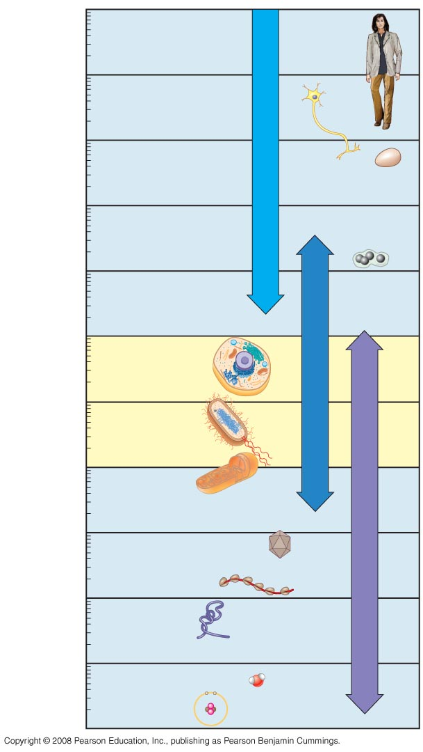
Fig. 6-2
10 m
1 m
Human height
Length of some nerve and muscle cells
0.1 m
Chicken egg
Unaided eye
1 cm
1 mm
Frog egg
100 µm
Most plant and animal cells
Light microscope
10 µm
Nucleus
Most bacteria
1 µm
Mitochondrion
100 nm
Smallest bacteria
Electron microscope
Viruses
10 nm
Ribosomes
Proteins
1 nm
Lipids
Small molecules
0.1 nm
Atoms
Notes:
Figure 6.2 The size range of cells

Slide 8
LMs can magnify effectively to about 1,000 times the size of the actual specimen
Various techniques enhance contrast and enable cell components to be stained or labeled
Most subcellular structures, including organelles (membrane-enclosed compartments), are too small to be resolved by an LM
Copyright © 2008 Pearson Education, Inc., publishing as Pearson Benjamin Cummings

Slide 9
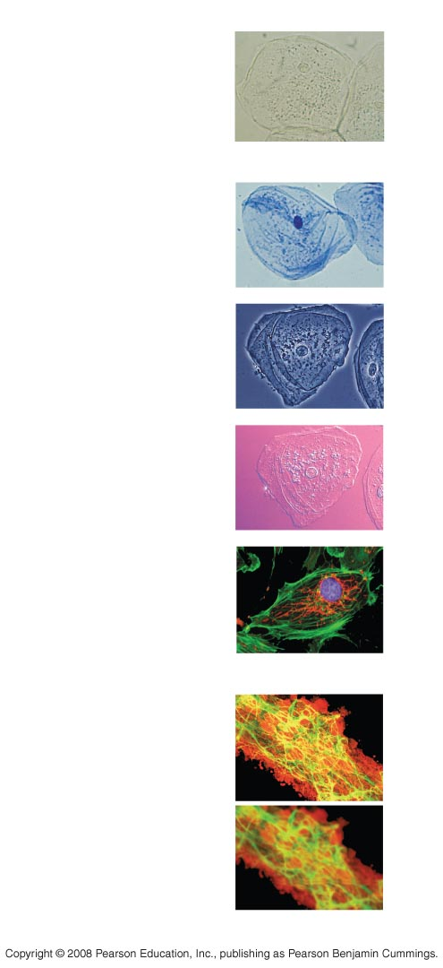
Fig. 6-3
TECHNIQUE
RESULTS
(a) Brightfield (unstained
specimen)
50 µm
(b) Brightfield (stained
specimen)
(c) Phase-contrast
(d) Differential-interference-
contrast (Nomarski)
(e) Fluorescence
50 µm
(f) Confocal
50 µm
Notes:
Figure 6.3a-d Light microscopy

Slide 10
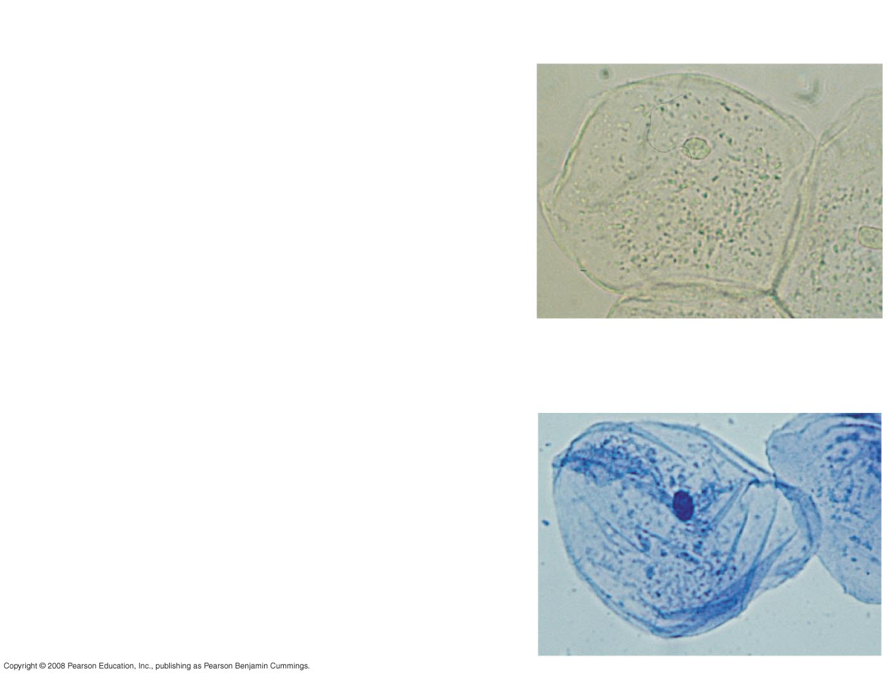
Fig. 6-3ab
TECHNIQUE
RESULTS
(a) Brightfield (unstained
specimen)
50 µm
(b) Brightfield (stained
specimen)
Notes:
Figure 6.3 Light microscopy

Slide 11
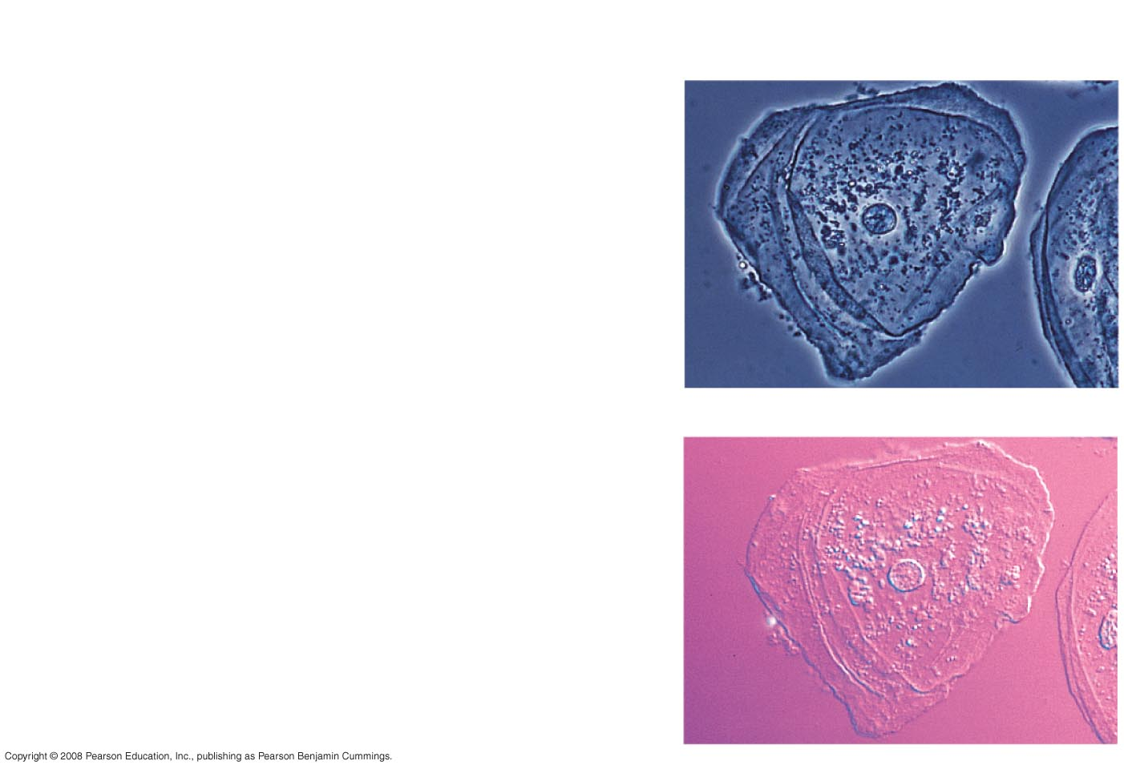
Fig. 6-3cd
TECHNIQUE
RESULTS
(c) Phase-contrast
(d) Differential-interference-
contrast (Nomarski)
Notes:
Figure 6.3 Light microscopy

Slide 12
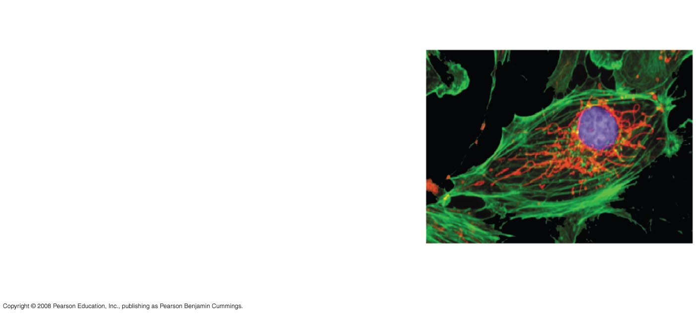
Fig. 6-3e
TECHNIQUE
RESULTS
(e) Fluorescence
50 µm
Notes:
Figure 6.3 Light microscopy

Slide 13
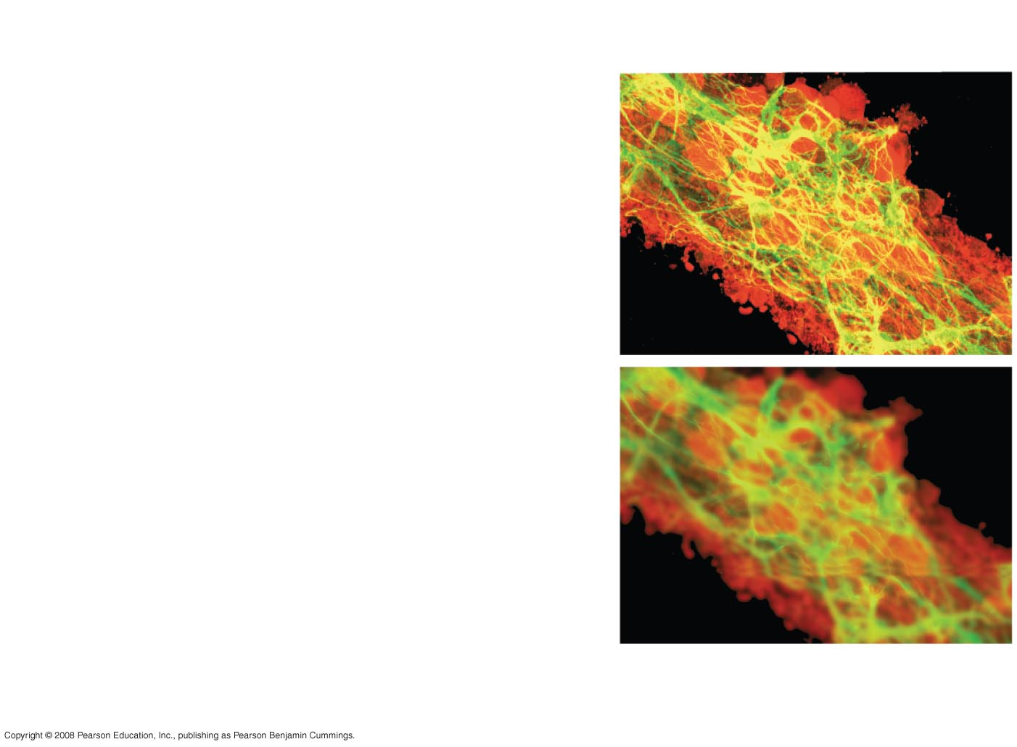
Fig. 6-3f
TECHNIQUE
RESULTS
(f) Confocal
50 µm
Notes:
Figure 6.3 Light microscopy

Slide 14
Two basic types of electron microscopes (EMs) are used to study subcellular structures
Scanning electron microscopes (SEMs) focus a beam of electrons onto the surface of a specimen, providing images that look 3-D
Transmission electron microscopes (TEMs) focus a beam of electrons through a specimen
TEMs are used mainly to study the internal structure of cells
Copyright © 2008 Pearson Education, Inc., publishing as Pearson Benjamin Cummings

Slide 15
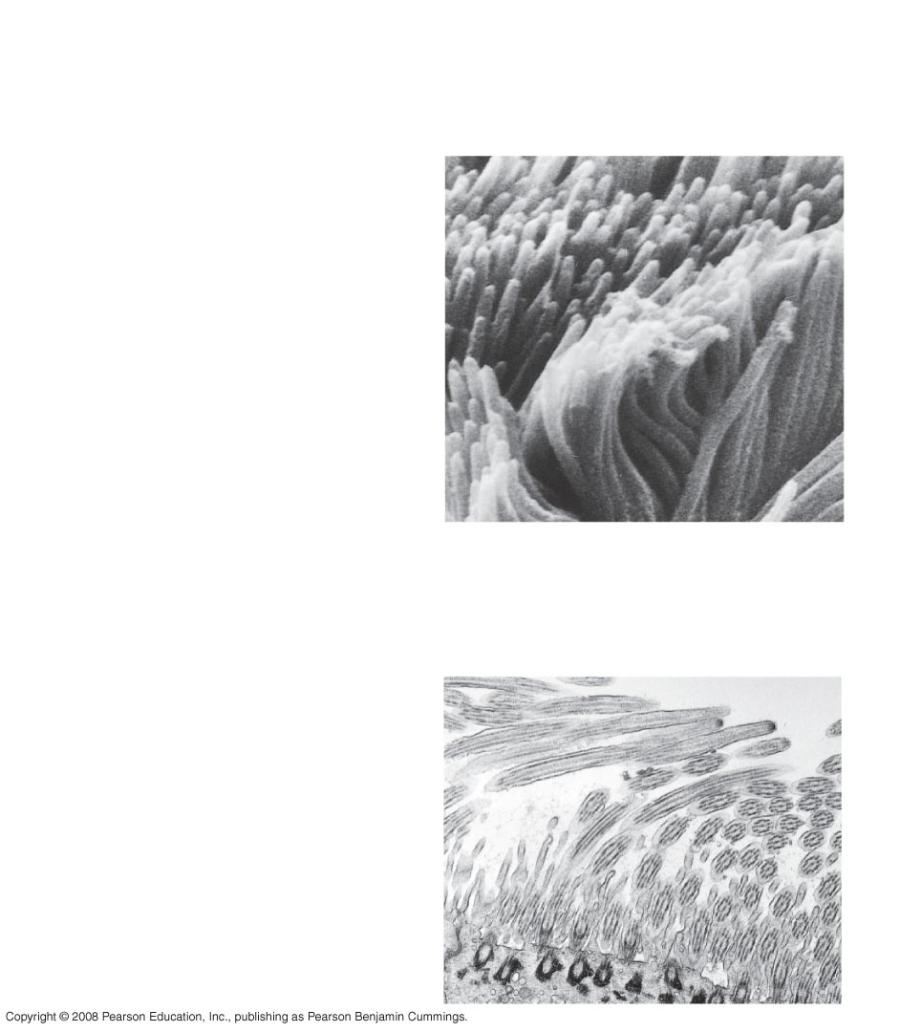
Fig. 6-4
TECHNIQUE
RESULTS
(a) Scanning electron
microscopy (SEM)
Cilia
1 µm
(b) Transmission electron
microscopy (TEM)
Longitudinal
section of
cilium
Cross section
of cilium
1 µm
Notes:
Figure 6.4 Electron microscopy

Slide 16
Cell Fractionation
Cell fractionation takes cells apart and separates the major organelles from one another
Ultracentrifuges fractionate cells into their component parts
Cell fractionation enables scientists to determine the functions of organelles
Biochemistry and cytology help correlate cell function with structure
Copyright © 2008 Pearson Education, Inc., publishing as Pearson Benjamin Cummings

Slide 17
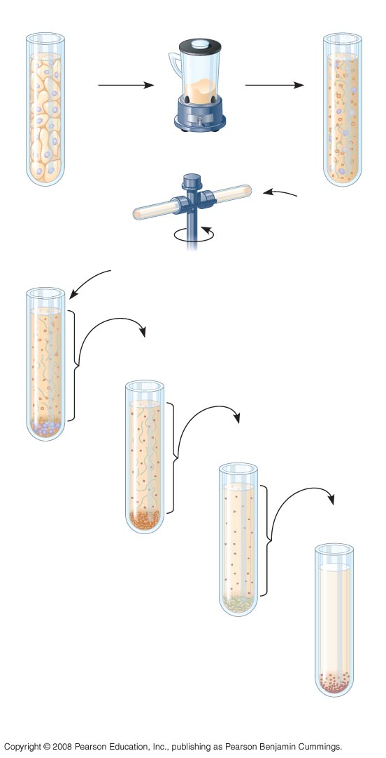
Fig. 6-5
TECHNIQUE
Homogenization
Tissue
cells
Homogenate
1,000 g
(1,000 times the
force of gravity)
10 min
Differential centrifugation
Supernatant poured
into next tube
20,000 g
20 min
80,000 g
60 min
Pellet rich in
nuclei and
cellular debris
150,000 g
3 hr
Pellet rich in
mitochondria
(and chloro-
plasts if cells
are from a plant)
Pellet rich in
“microsomes”
(pieces of plasma
membranes and
cells’ internal
membranes)
Pellet rich in
ribosomes
Notes:
Figure 6.5 Cell fractionation

Slide 18
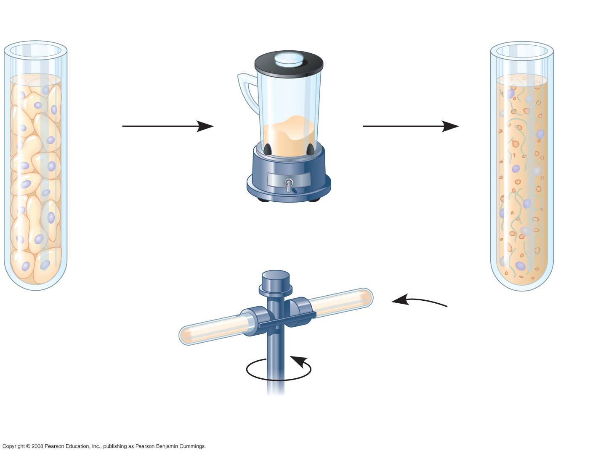
Fig. 6-5a
TECHNIQUE
Homogenization
Tissue
cells
Homogenate
Differential centrifugation
Notes:
Figure 6.5 Cell fractionation, part 1

Slide 19
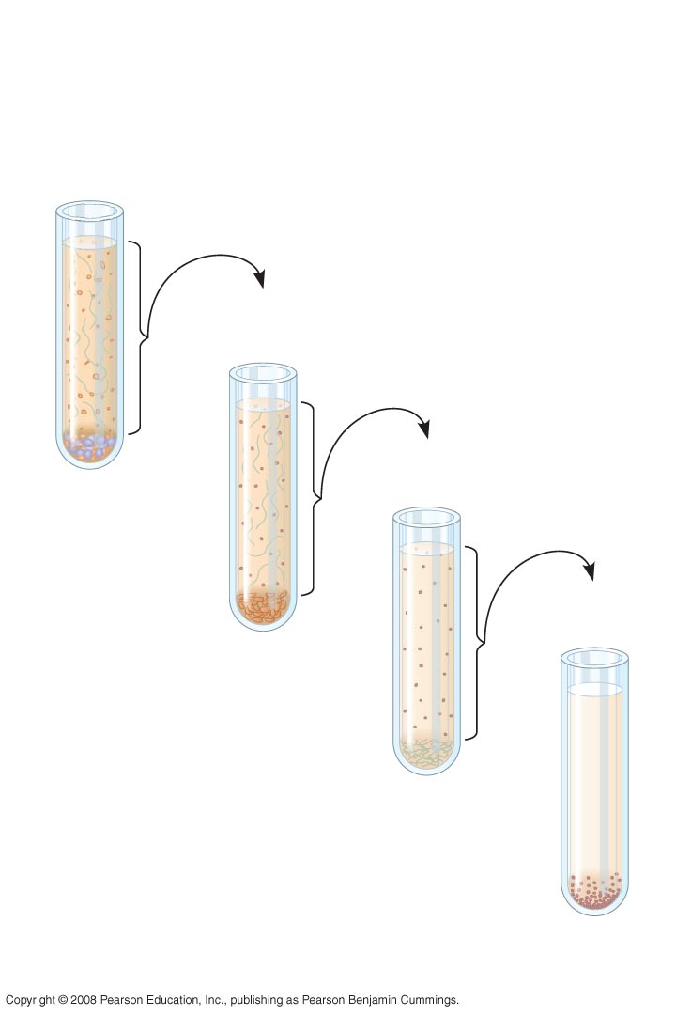
Fig. 6-5b
TECHNIQUE (cont.)
1,000 g
(1,000 times the force of gravity)
10 min
Supernatant poured into next tube
20,000 g
20 min
80,000 g
60 min
Pellet rich in nuclei and cellular debris
150,000 g
3 hr
Pellet rich in mitochondria (and chloro-plasts if cells
are from a plant)
Pellet rich in “microsomes” (pieces of plasma
membranes and cells’ internal membranes)
Pellet rich in ribosomes
Notes:
Figure 6.5 Cell fractionation, part 2

Slide 20
Concept 6.2: Eukaryotic cells have internal membranes that compartmentalize their functions
The basic structural and functional unit of every organism is one of two types of cells: prokaryotic or eukaryotic
Only organisms of the domains Bacteria and Archaea consist of prokaryotic cells
Protists, fungi, animals, and plants all consist of eukaryotic cells
Copyright © 2008 Pearson Education, Inc., publishing as Pearson Benjamin Cummings

Slide 21
Comparing Prokaryotic and Eukaryotic Cells
Basic features of all cells:
Plasma membrane
Semifluid substance called cytosol
Chromosomes (carry genes)
Ribosomes (make proteins)
Copyright © 2008 Pearson Education, Inc., publishing as Pearson Benjamin Cummings

Slide 22
Prokaryotic cells are characterized by having
No nucleus
DNA in an unbound region called the nucleoid
No membrane-bound organelles
Cytoplasm bound by the plasma membrane
Copyright © 2008 Pearson Education, Inc., publishing as Pearson Benjamin Cummings

Slide 23
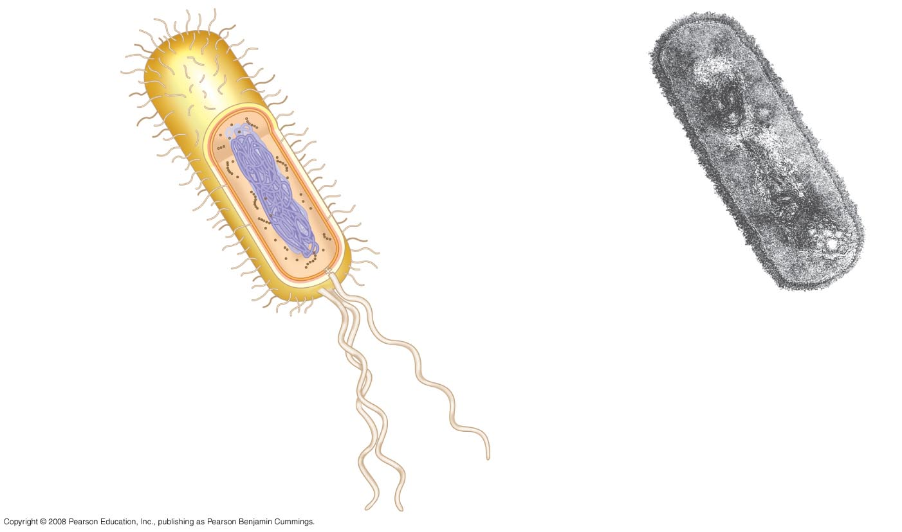
Fig. 6-6
Fimbriae
Nucleoid
Ribosomes
Plasma membrane
Bacterial
chromosome
Cell wall
Capsule
0.5 µm
(a)
A typical rod-shaped bacterium
Flagella
(b)
A thin section through the bacterium Bacillus coagulans (TEM)
Notes:
Figure 6.6 A prokaryotic cell

Slide 24
Eukaryotic cells are characterized by having
DNA in a nucleus that is bounded by a membranous nuclear envelope
Membrane-bound organelles
Cytoplasm in the region between the plasma membrane and nucleus
Eukaryotic cells are generally much larger than prokaryotic cells
Copyright © 2008 Pearson Education, Inc., publishing as Pearson Benjamin Cummings

Slide 25
The plasma membrane is a selective barrier that allows sufficient passage of oxygen, nutrients, and waste to service the volume of every cell
The general structure of a biological membrane is a double layer of phospholipids
Copyright © 2008 Pearson Education, Inc., publishing as Pearson Benjamin Cummings

Slide 26
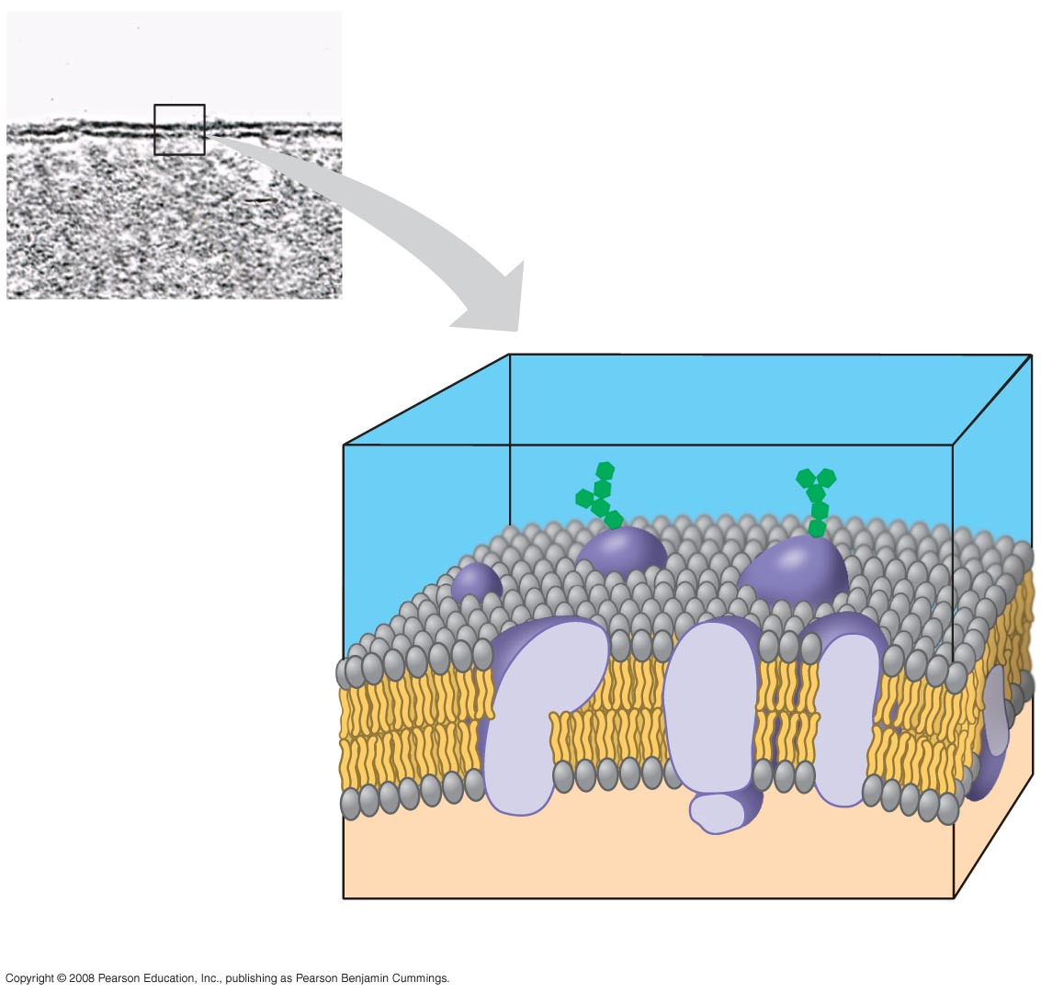
Fig. 6-7
(a)
TEM of a plasma
membrane
Outside of cell
Inside of
cell
0.1 µm
Carbohydrate side chain
Hydrophilic
region
Hydrophobic
region
Hydrophilic
region
Phospholipid
Proteins
(b) Structure of the plasma membrane
Notes:
Figure 6.7 The plasma membrane

Slide 27
The logistics of carrying out cellular metabolism sets limits on the size of cells
The surface area to volume ratio of a cell is critical
As the surface area increases by a factor of n², the volume increases by a factor of n³
Small cells have a greater surface area relative to volume
Copyright © 2008 Pearson Education, Inc., publishing as Pearson Benjamin Cummings

Slide 28
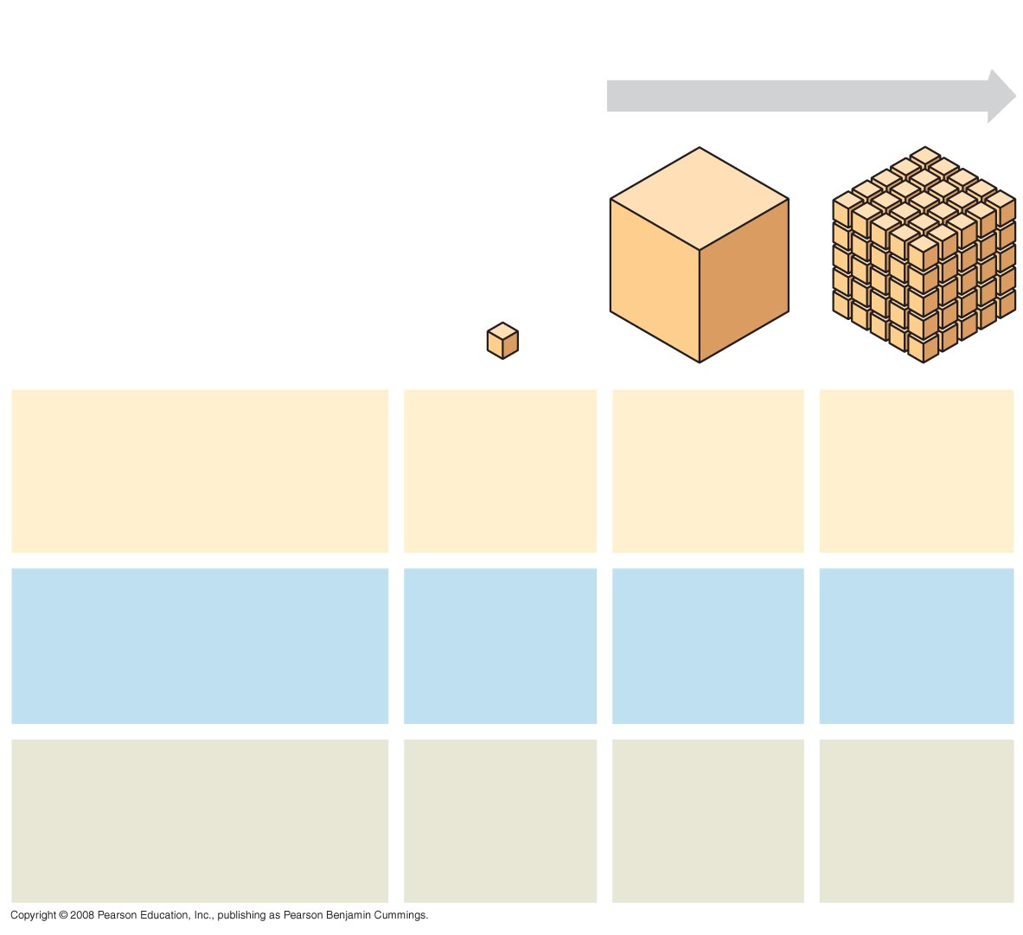
Fig. 6-8
Surface area increases while
total volume remains constant
5
1
1
Total surface area
[Sum of the surface areas
(height × width) of all boxes
sides × number of boxes]
6
150
750
Total volume
[height × width × length ×
number of boxes]
1
125
125
Surface-to-volume
(S-to-V) ratio
[surface area ÷ volume]
6
1.2
6
Notes:
Figure 6.8 Geometric relationships between surface area and volume

Slide 29
A Panoramic View of the Eukaryotic Cell
A eukaryotic cell has internal membranes that partition the cell into organelles
Plant and animal cells have most of the same organelles
Copyright © 2008 Pearson Education, Inc., publishing as Pearson Benjamin Cummings

Slide 30
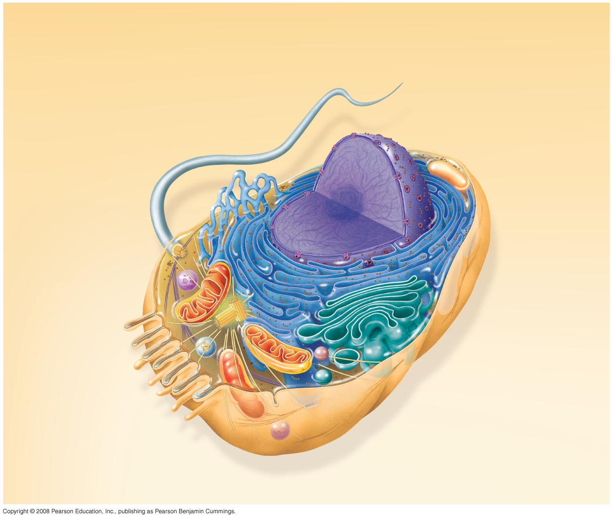
Fig. 6-9a
Nuclear
envelope
ENDOPLASMIC RETICULUM (ER)
NUCLEUS
Nucleolus
Rough ER
Smooth ER
Flagellum
Chromatin
Centrosome
Plasma membrane
CYTOSKELETON:
Microfilaments
Intermediate
filaments
Microtubules
Ribosomes
Microvilli
Golgi
apparatus
Peroxisome
Mitochondrion
Lysosome
Notes:
Figure 6.9 Animal and plant cells—animal cell

Slide 31
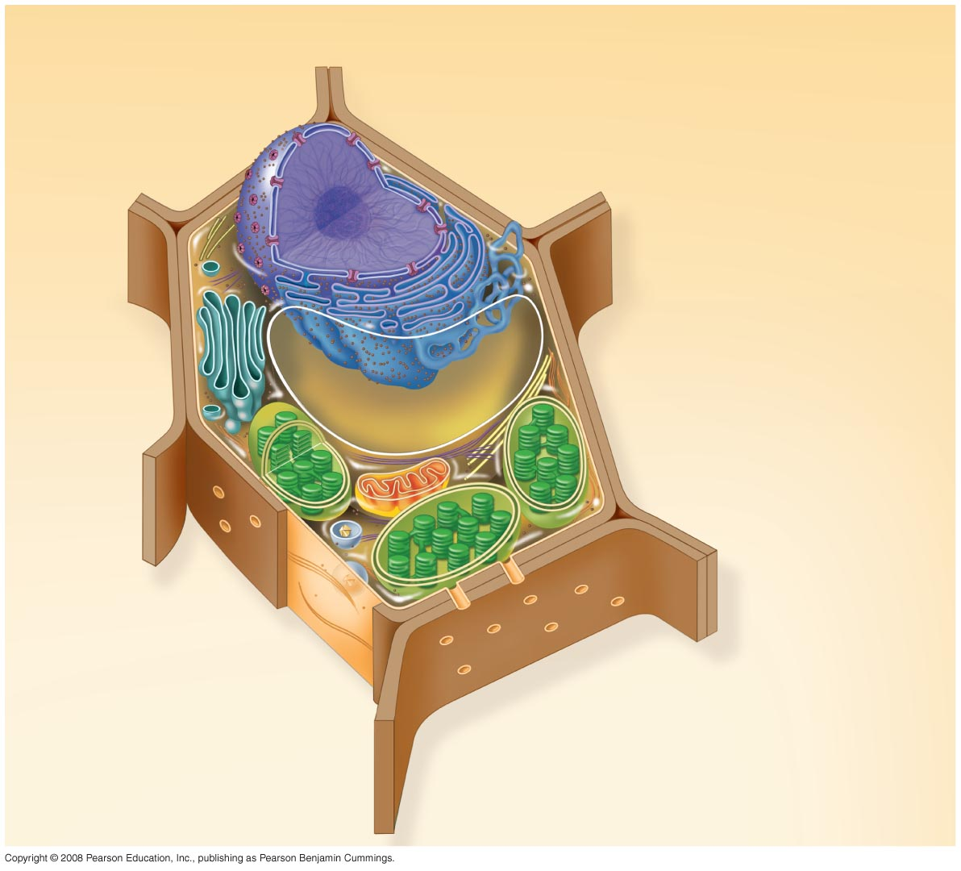
Fig. 6-9b
Nuclear envelope
Rough endoplasmic reticulum
NUCLEUS
Nucleolus
Chromatin
Smooth endoplasmic reticulum
Ribosomes
Golgi
apparatus
Central vacuole
Microfilaments
Intermediate filaments
CYTO-
SKELETON
Microtubules
Mitochondrion
Peroxisome
Plasma membrane
Chloroplast
Cell wall
Plasmodesmata
Wall of adjacent cell
Notes:
Figure 6.9 Animal and plant cells—plant cell

Slide 32
Concept 6.3: The eukaryotic cell’s genetic instructions are housed in the nucleus and carried out by the ribosomes
The nucleus contains most of the DNA in a eukaryotic cell
Ribosomes use the information from the DNA to make proteins
Copyright © 2008 Pearson Education, Inc., publishing as Pearson Benjamin Cummings

Slide 33
The Nucleus: Information Central
The nucleus contains most of the cell’s genes and is usually the most conspicuous organelle
The nuclear envelope encloses the nucleus, separating it from the cytoplasm
The nuclear membrane is a double membrane; each membrane consists of a lipid bilayer
Copyright © 2008 Pearson Education, Inc., publishing as Pearson Benjamin Cummings

Slide 34
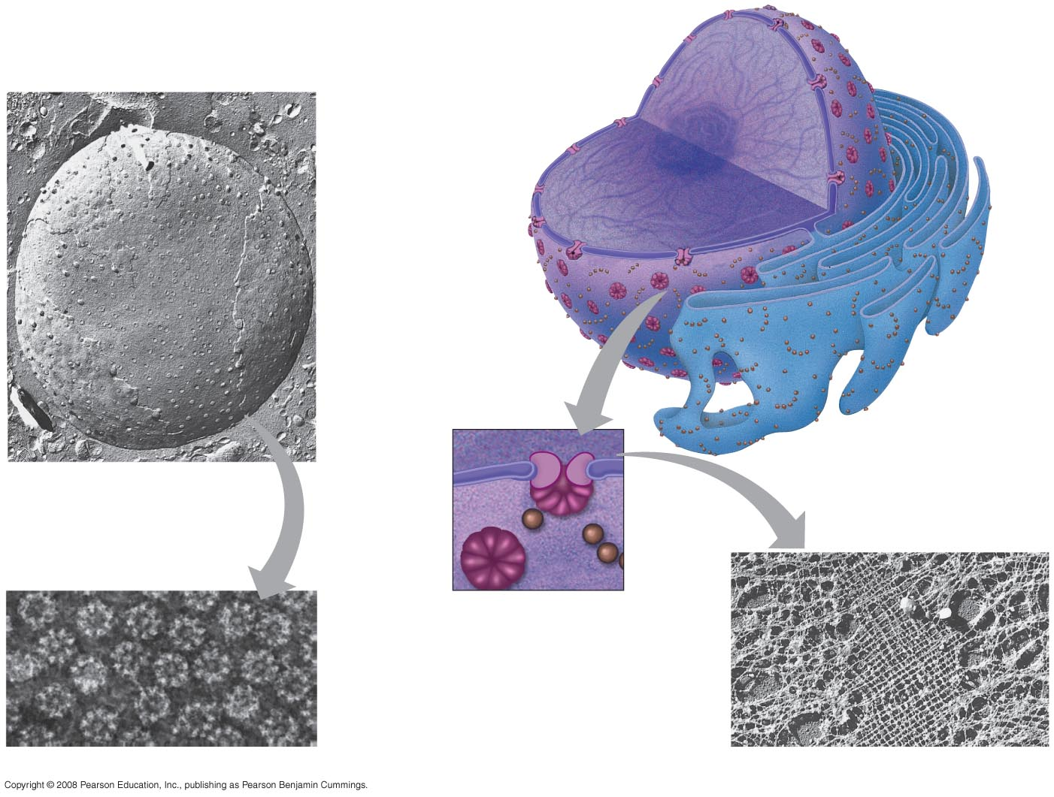
Fig. 6-10
Nucleus
1 µm
Nucleolus
Chromatin
Nuclear envelope:
Inner membrane
Outer membrane
Nuclear pore
Pore complex
Rough ER
Surface of
nuclear envelope
Ribosome
1 µm
0.25 µm
Close-up of nuclear envelope
Pore complexes (TEM)
Nuclear lamina (TEM)
Notes:
Figure 6.10 The nucleus and its envelope

Slide 35
Pores regulate the entry and exit of molecules from the nucleus
The shape of the nucleus is maintained by the nuclear lamina, which is composed of protein
Copyright © 2008 Pearson Education, Inc., publishing as Pearson Benjamin Cummings

Slide 36
In the nucleus, DNA and proteins form genetic material called chromatin
Chromatin condenses to form discrete chromosomes
The nucleolus is located within the nucleus and is the site of ribosomal RNA (rRNA) synthesis
Copyright © 2008 Pearson Education, Inc., publishing as Pearson Benjamin Cummings

Slide 37
Ribosomes: Protein Factories
Ribosomes are particles made of ribosomal RNA and protein
Ribosomes carry out protein synthesis in two locations:
In the cytosol (free ribosomes)
On the outside of the endoplasmic reticulum or the nuclear envelope (bound ribosomes)
Copyright © 2008 Pearson Education, Inc., publishing as Pearson Benjamin Cummings
Notes:
For the Cell Biology Video Staining of Endoplasmic Reticulum, go to Animation and Video Files.

Slide 38
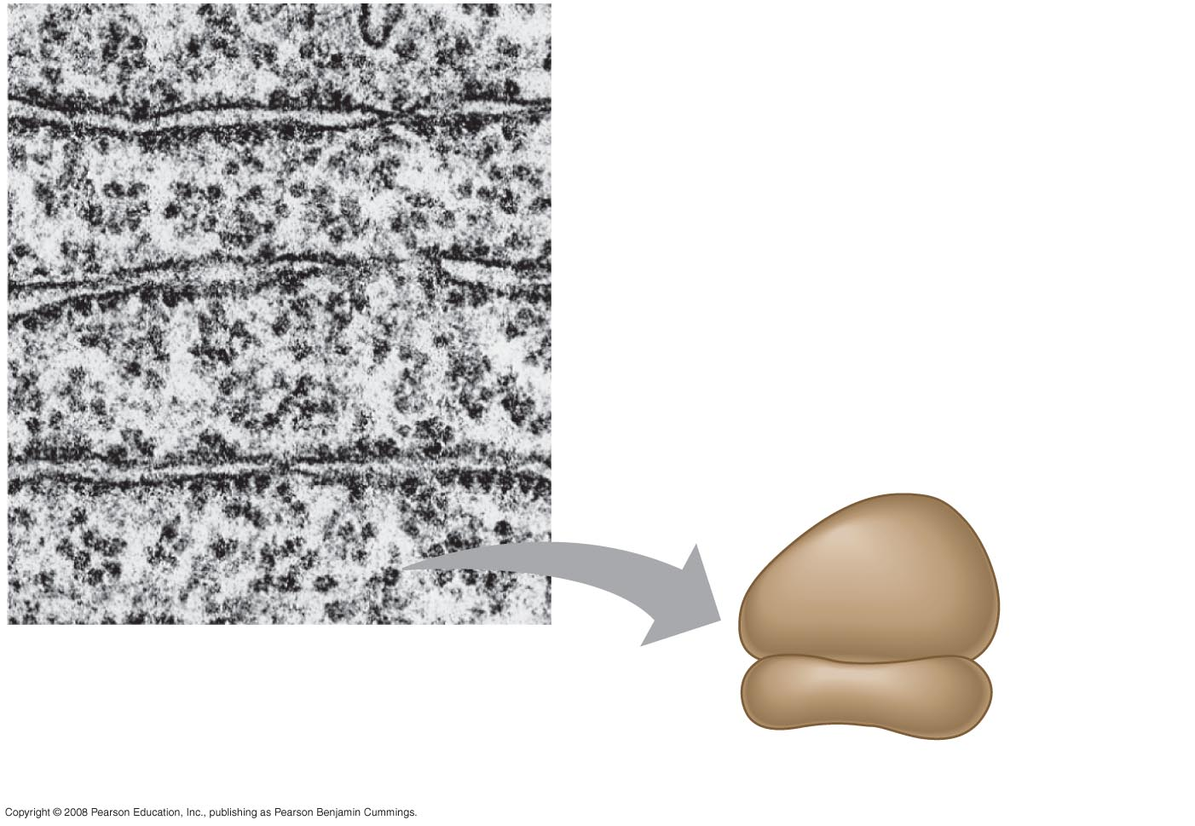
Fig. 6-11
Cytosol
Endoplasmic reticulum (ER)
Free ribosomes
Bound ribosomes
Large subunit
Small subunit
0.5 µm
TEM showing ER and ribosomes
Diagram of a ribosome
Notes:
Figure 6.11 Ribosomes

Slide 39
Concept 6.4: The endomembrane system regulates protein traffic and performs metabolic functions in the cell
Components of the endomembrane system:
Nuclear envelope
Endoplasmic reticulum
Golgi apparatus
Lysosomes
Vacuoles
Plasma membrane
These components are either continuous or connected via transfer by vesicles
Copyright © 2008 Pearson Education, Inc., publishing as Pearson Benjamin Cummings

Slide 40
The Endoplasmic Reticulum: Biosynthetic Factory
The endoplasmic reticulum (ER) accounts for more than half of the total membrane in many eukaryotic cells
The ER membrane is continuous with the nuclear envelope
There are two distinct regions of ER:
Smooth ER, which lacks ribosomes
Rough ER, with ribosomes studding its surface
Copyright © 2008 Pearson Education, Inc., publishing as Pearson Benjamin Cummings
Notes:
For the Cell Biology Video ER and Mitochondria in Leaf Cells, go to Animation and Video Files.

Slide 41
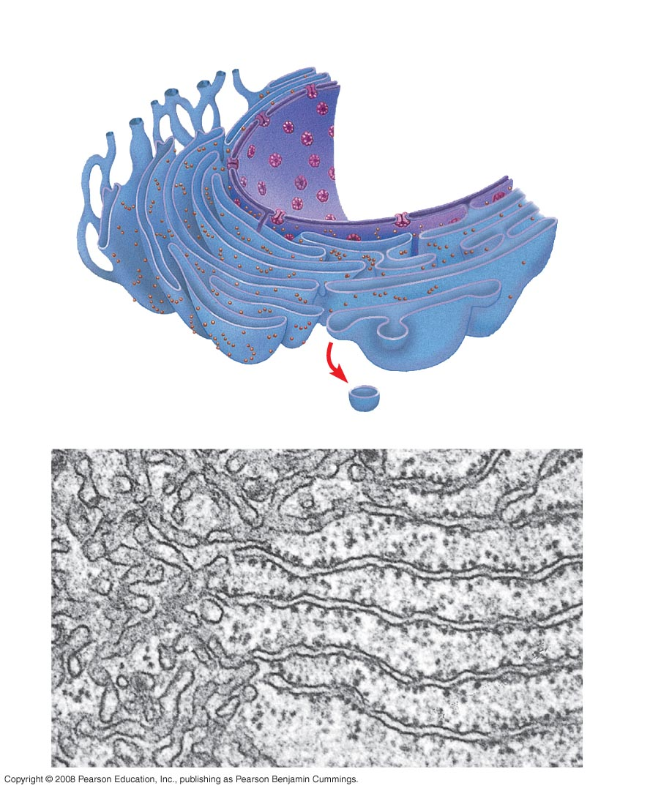
Fig. 6-12
Smooth ER
Rough ER
Nuclear envelope
ER lumen
Cisternae
Transitional ER
Ribosomes
Transport vesicle
Smooth ER
Rough ER
200 nm
Notes:
Figure 6.12 Endoplasmic reticulum (ER)

Slide 42
Functions of Smooth ER
The smooth ER
Synthesizes lipids
Metabolizes carbohydrates
Detoxifies poison
Stores calcium
Copyright © 2008 Pearson Education, Inc., publishing as Pearson Benjamin Cummings

Slide 43
Functions of Rough ER
The rough ER
Has bound ribosomes, which secrete glycoproteins (proteins covalently bonded to carbohydrates)
Distributes transport vesicles, proteins surrounded by membranes
Is a membrane factory for the cell
Copyright © 2008 Pearson Education, Inc., publishing as Pearson Benjamin Cummings

Slide 44
The Golgi Apparatus: Shipping and Receiving Center
The Golgi apparatus consists of flattened membranous sacs called cisternae
Functions of the Golgi apparatus:
Modifies products of the ER
Manufactures certain macromolecules
Sorts and packages materials into transport vesicles
Copyright © 2008 Pearson Education, Inc., publishing as Pearson Benjamin Cummings
Notes:
For the Cell Biology Video ER to Golgi Traffic, go to Animation and Video Files.
For the Cell Biology Video Golgi Complex in 3D, go to Animation and Video Files.
For the Cell Biology Video Secretion From the Golgi, go to Animation and Video Files.

Slide 45
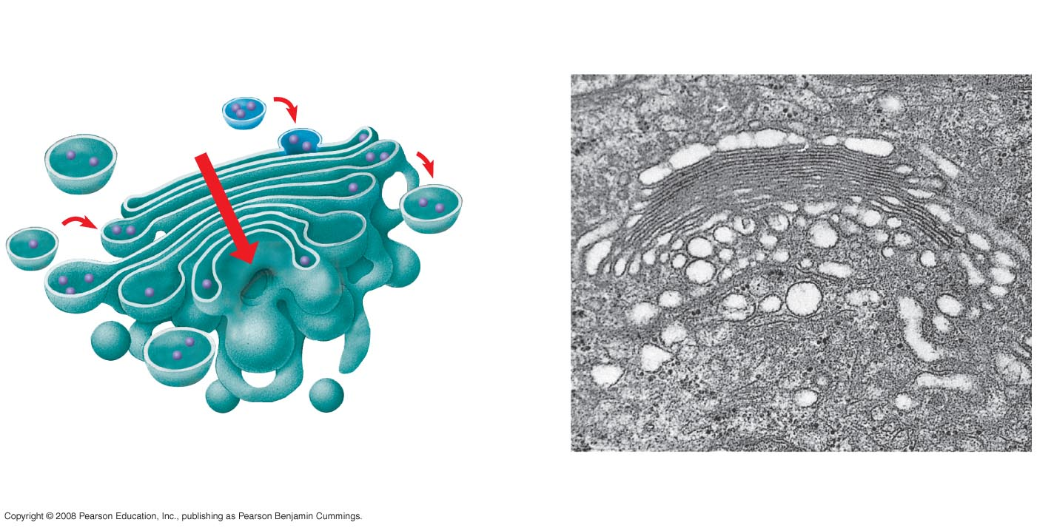
Fig. 6-13
cis face
(“receiving” side of Golgi apparatus)
0.1 µm
Cisternae
trans face
(“shipping” side of Golgi apparatus)
TEM of Golgi apparatus
Notes:
Figure 6.13 The Golgi apparatus

Slide 46
Lysosomes: Digestive Compartments
A lysosome is a membranous sac of hydrolytic enzymes that can digest macromolecules
Lysosomal enzymes can hydrolyze proteins, fats, polysaccharides, and nucleic acids
Copyright © 2008 Pearson Education, Inc., publishing as Pearson Benjamin Cummings

Slide 47
Some types of cell can engulf another cell by phagocytosis; this forms a food vacuole
A lysosome fuses with the food vacuole and digests the molecules
Lysosomes also use enzymes to recycle the cell’s own organelles and macromolecules, a process called autophagy
Copyright © 2008 Pearson Education, Inc., publishing as Pearson Benjamin Cummings
Notes:
For the Cell Biology Video Phagocytosis in Action, go to Animation and Video Files.

Slide 48
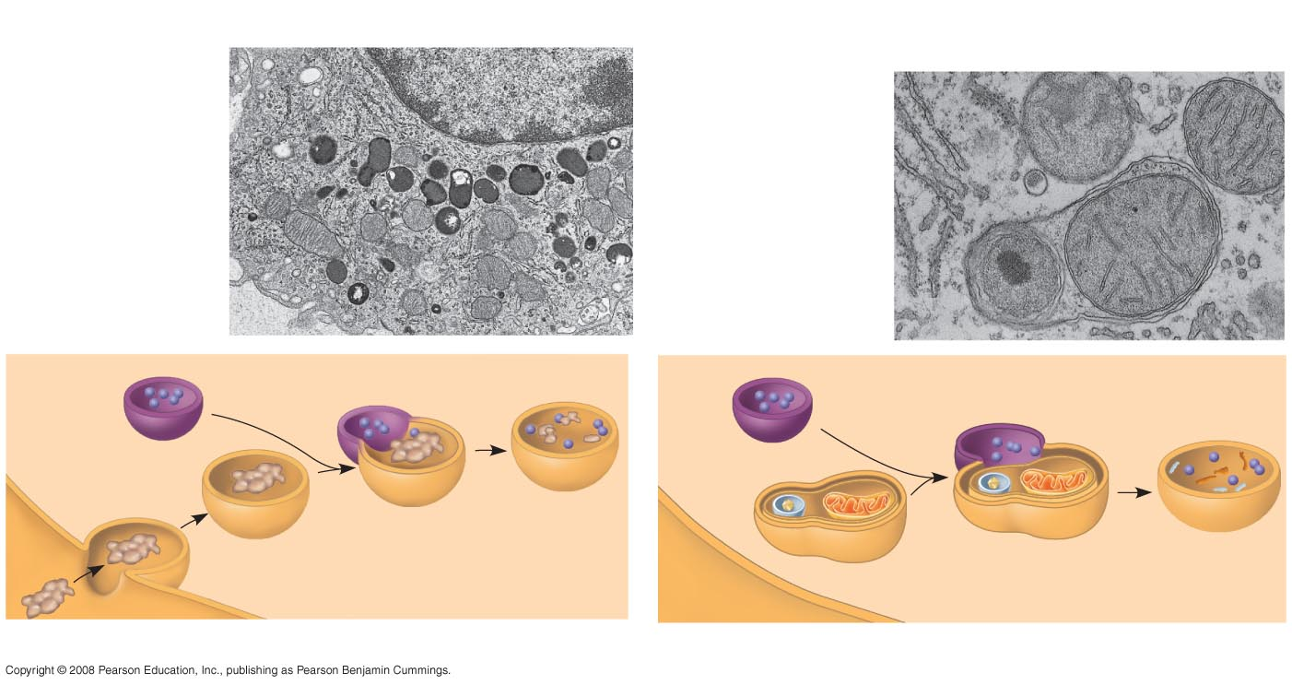
Fig. 6-14
Nucleus
1 µm
Vesicle containing
two damaged organelles
1 µm
Mitochondrion
fragment
Peroxisome
fragment
Lysosome
Digestive
enzymes
Lysosome
Lysosome
Plasma
membrane
Peroxisome
Digestion
Food vacuole
Mitochondrion
Digestion
Vesicle
(a) Phagocytosis
(b) Autophagy
Notes:
Figure 6.14a Lysosomes

Slide 49
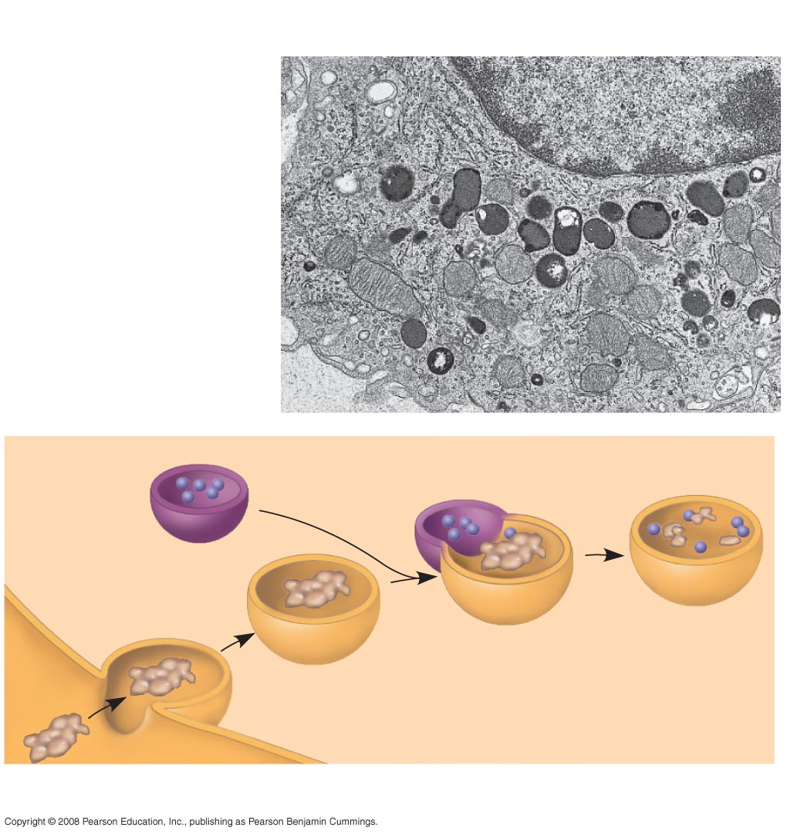
Fig. 6-14a
1 µm
Nucleus
Lysosome
Digestive enzymes
Lysosome
Plasma membrane
Digestion
Food vacuole
(a) Phagocytosis
Notes:
Figure 6.14a Lysosome—phagocytosis

Slide 50
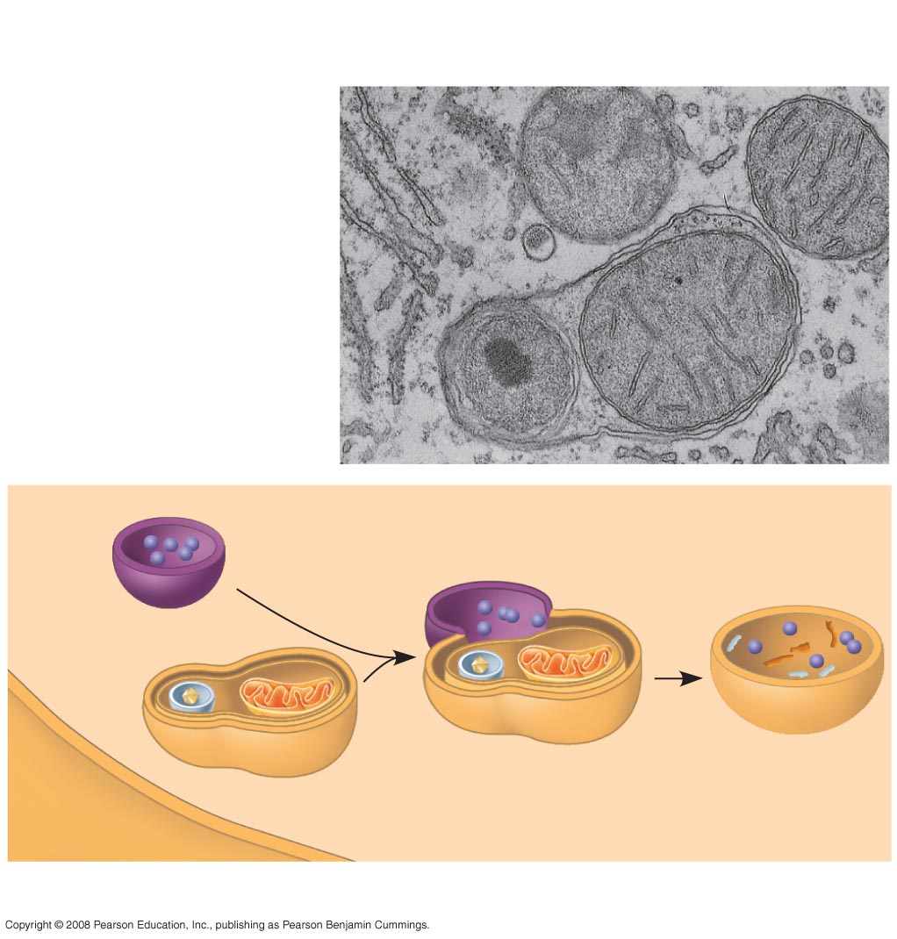
Fig. 6-14b
Vesicle containing
two damaged organelles
1 µm
Mitochondrion fragment
Peroxisome fragment
Lysosome
Peroxisome
Mitochondrion
Digestion
Vesicle
(b) Autophagy
Notes:
Figure 6.14b Lysosomes—autophagy

Slide 51
Vacuoles: Diverse Maintenance Compartments
A plant cell or fungal cell may have one or several vacuoles
Copyright © 2008 Pearson Education, Inc., publishing as Pearson Benjamin Cummings

Slide 52
Food vacuoles are formed by phagocytosis
Contractile vacuoles, found in many freshwater protists, pump excess water out of cells
Central vacuoles, found in many mature plant cells, hold organic compounds and water
Copyright © 2008 Pearson Education, Inc., publishing as Pearson Benjamin Cummings

Slide 53
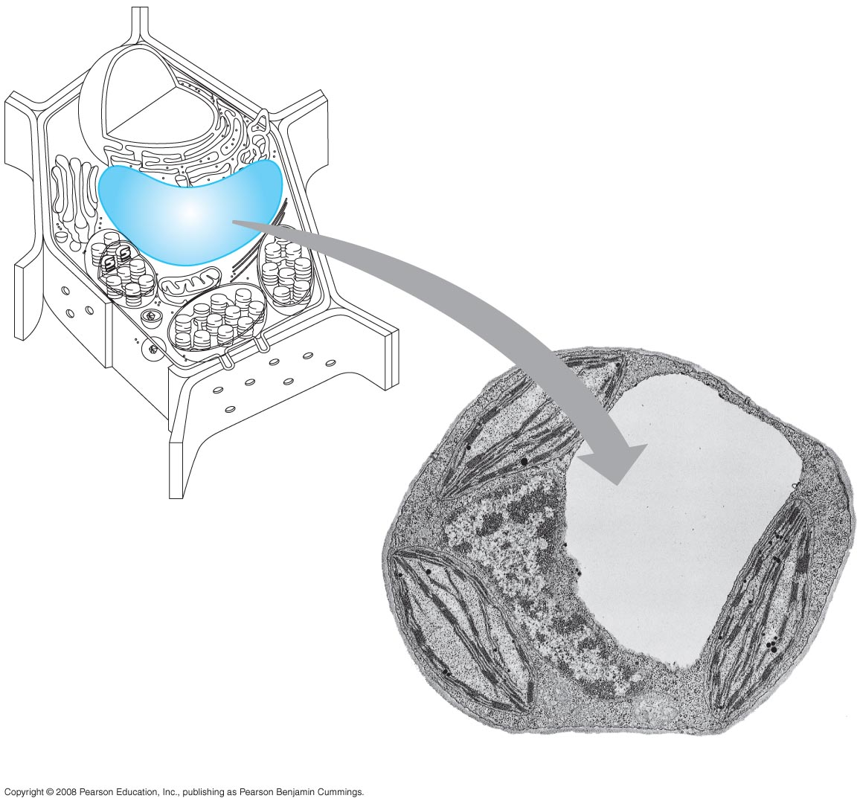
Fig. 6-15
Central vacuole
Cytosol
Nucleus
Central vacuole
Cell wall
Chloroplast
5 µm
Notes:
Figure 6.15 The plant cell vacuole

Slide 54
The Endomembrane System: A Review
The endomembrane system is a complex and dynamic player in the cell’s compartmental organization
Copyright © 2008 Pearson Education, Inc., publishing as Pearson Benjamin Cummings

Slide 55
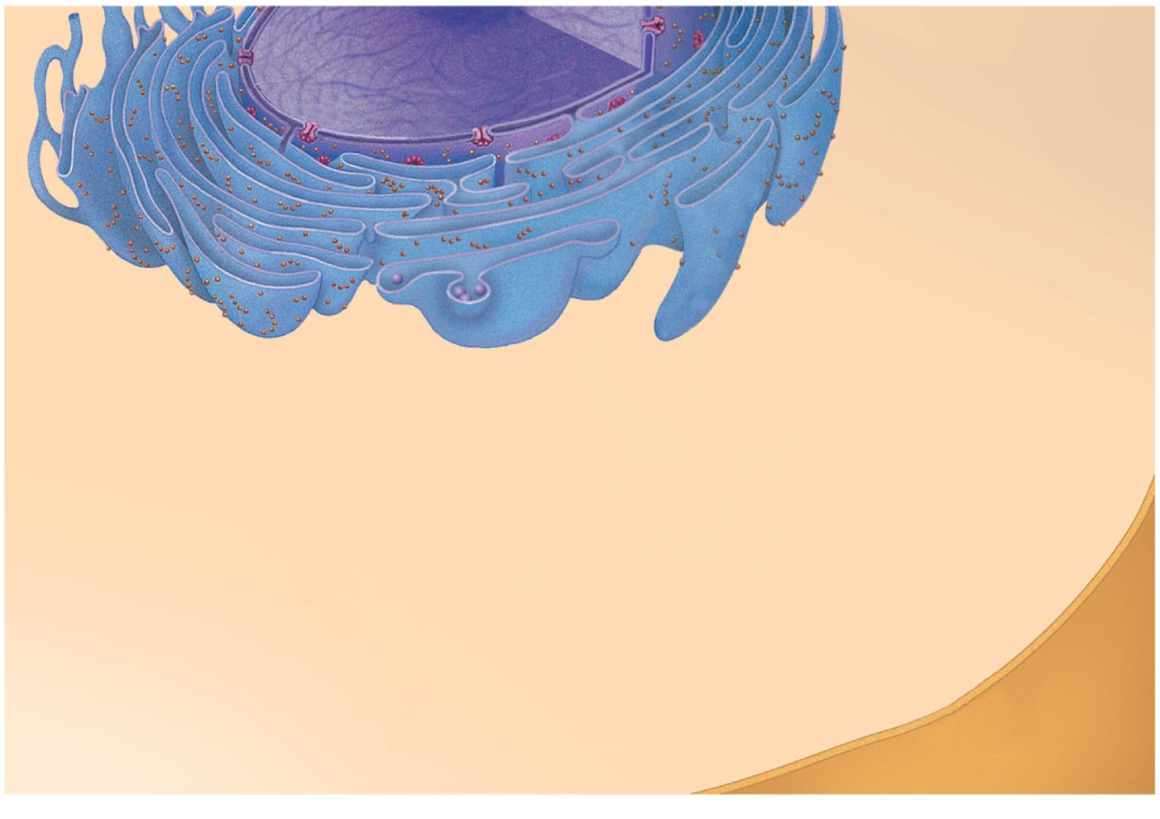
Fig. 6-16-1
Nucleus
Rough ER
Smooth ER
Plasma membrane
Notes:
Figure 6.16 Review: relationships among organelles of the endomembrane system

Slide 56
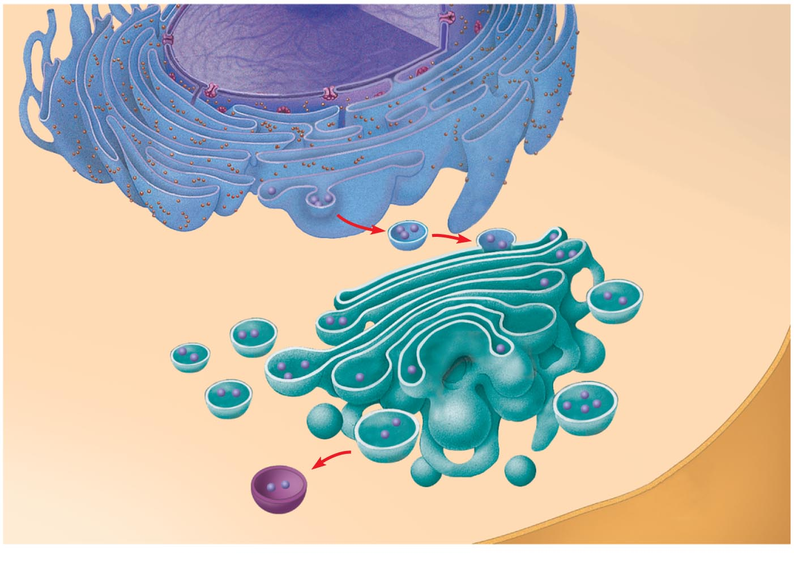
Fig. 6-16-2
Nucleus
Rough ER
Smooth ER
cis Golgi
Plasma membrane
trans Golgi
Notes:
Figure 6.16 Review: relationships among organelles of the endomembrane system

Slide 57
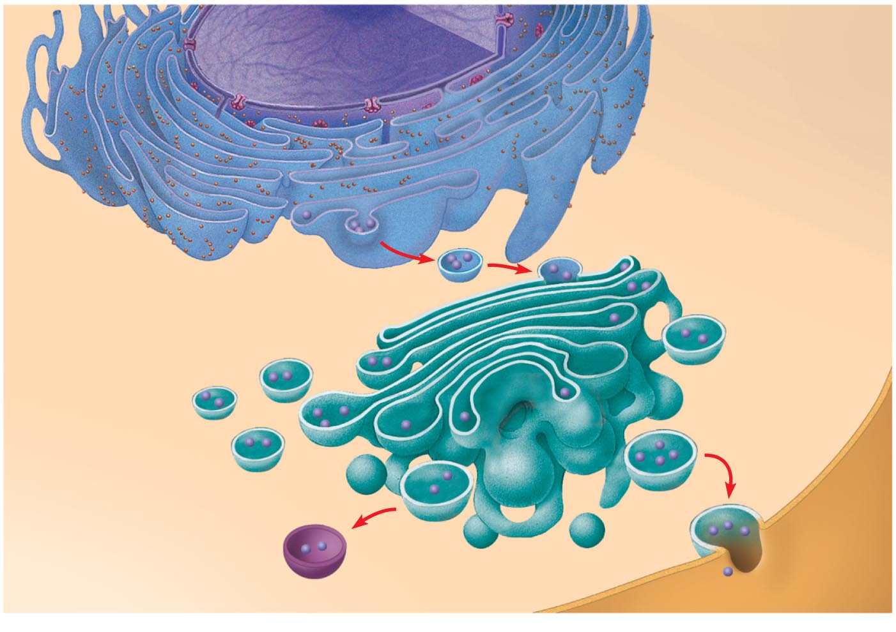
Fig. 6-16-3
Nucleus
Rough ER
Smooth ER
cis Golgi
Plasma membrane
trans Golgi
Notes:
Figure 6.16 Review: relationships among organelles of the endomembrane system

