Slide 1
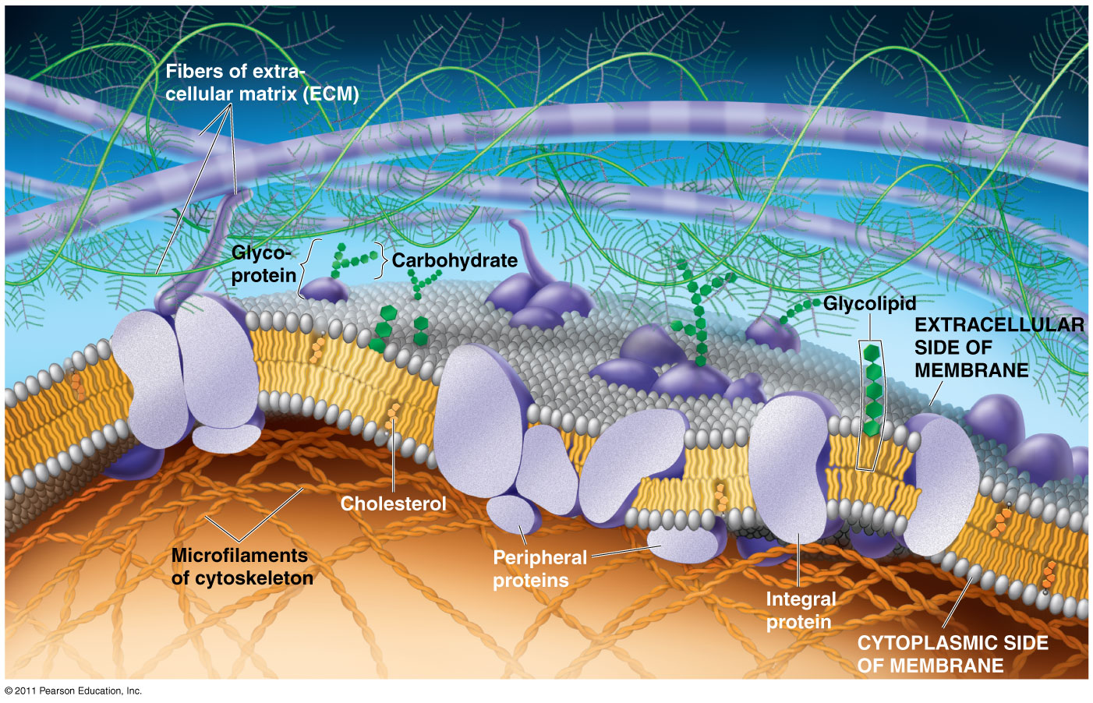
Chapter 7
Membrane Structure and Function

Slide 2
What You Must Know:
Why membranes are selectively permeable.
The role of phospholipids, proteins, and carbohydrates in membranes.
How water will move if a cell is placed in an isotonic, hypertonic, or hypotonic solution.
How electrochemical gradients are formed.

Slide 3
Cell Membrane
Plasma membrane is selectively permeable
Allows some substances to cross more easily than others
Fluid Mosaic Model
Fluid: membrane held together by weak interactions
Mosaic: phospholipids, proteins, carbs

Slide 4
Early membrane model
(1935) Davson/Danielli – Sandwich model
phospholipid bilayer between 2 protein layers
Problems: varying chemical composition of membrane, hydrophobic protein parts

Slide 5
The freeze-fracture method: revealed the structure of membrane’s interior

Slide 6
Fluid Mosaic Model

Slide 8
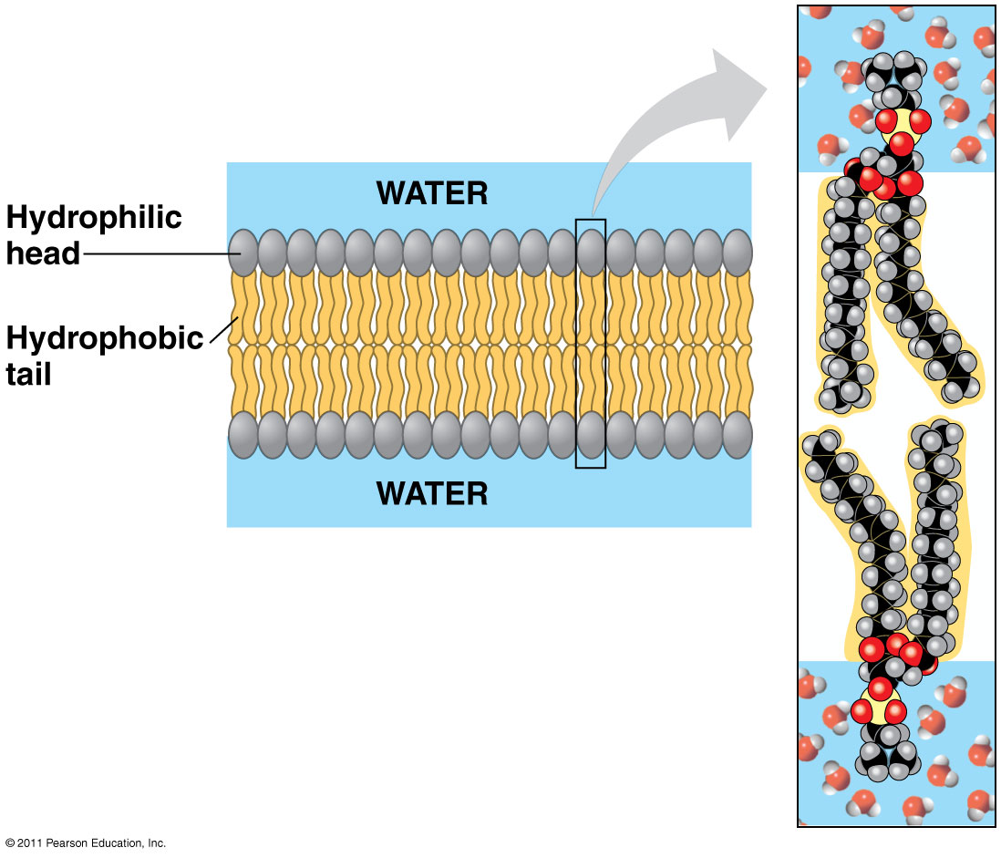
Phospholipids
Bilayer
Amphipathic = hydrophilic head, hydrophobic tail
Hydrophobic barrier: keeps hydrophilic molecules out

Slide 9
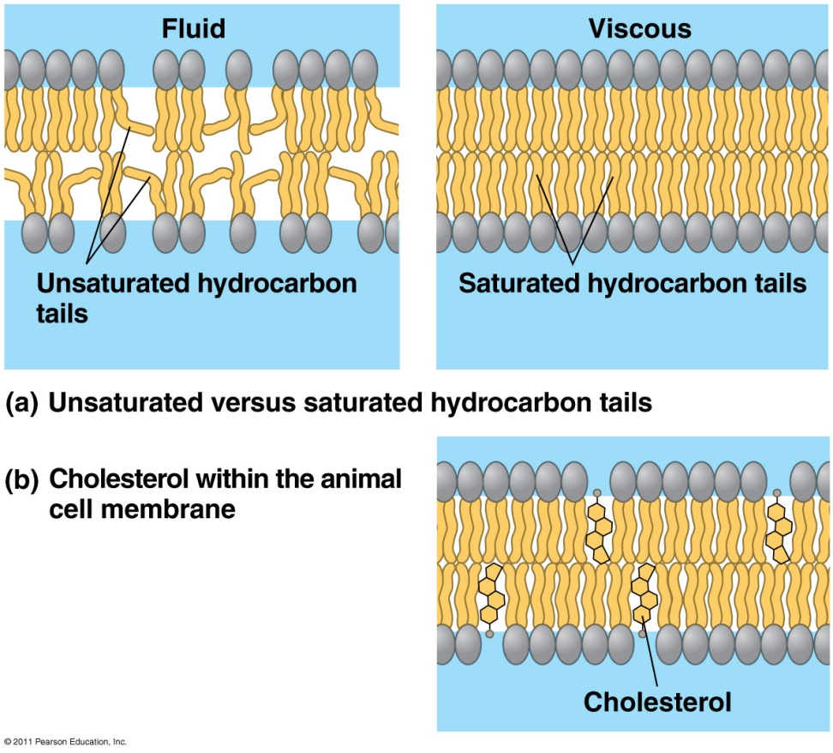
Membrane fluidity
Low temps: phospholipids w/unsaturated tails (kinks prevent close packing)
Cholesterol resists changes by:
limit fluidity at high temps
hinder close packing at low temps
Adaptations: bacteria in hot springs (unusual lipids); winter wheat (↑ unsaturated phospholipids)

Slide 10
Membrane Proteins
Integral Proteins
Peripheral Proteins
Embedded in membrane
Determined by freeze fracture
Transmembrane with hydrophilic heads/tails and hydrophobic middles
Extracellular or cytoplasmic sides of membrane
NOT embedded
Held in place by the cytoskeleton or ECM
Provides stronger framework

Slide 11
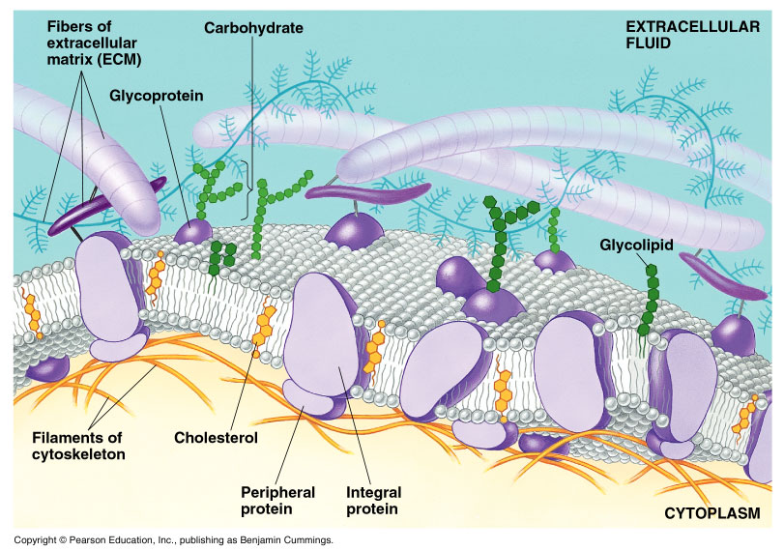
Integral & Peripheral proteins

Slide 12
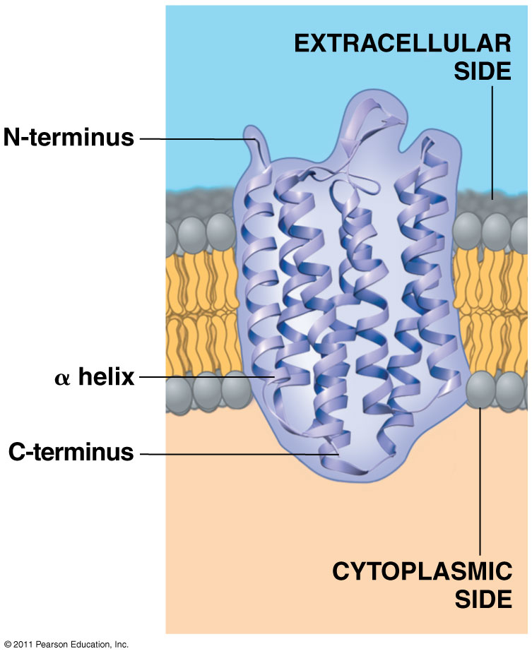
Transmembrane protein structure
Hydrophobic interior
Hydrophilic ends

Slide 13
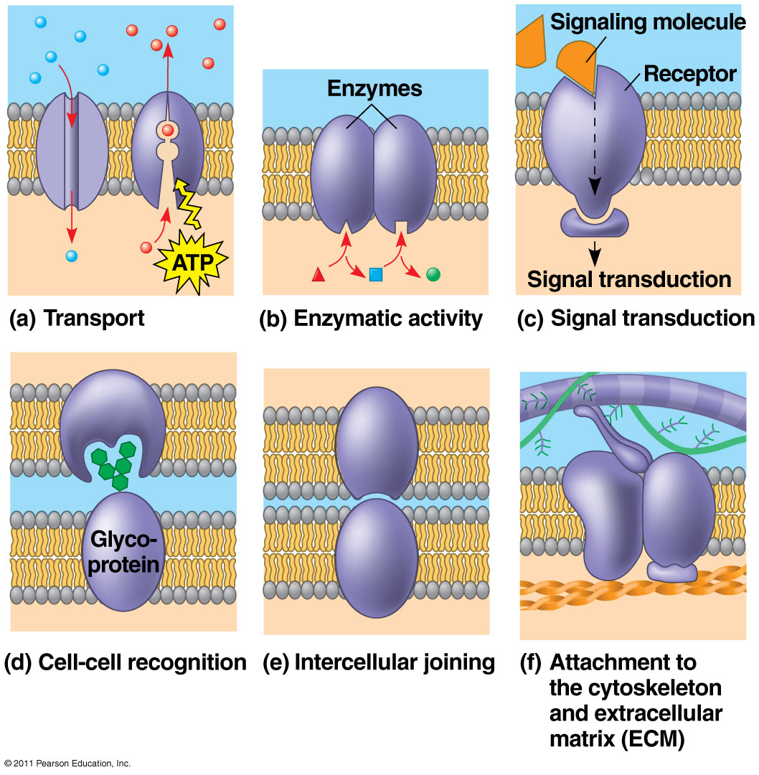
Some functions of membrane proteins

Slide 14
Carbohydrates
Function: cell-cell recognition; developing organisms
Glycolipids, glycoproteins
Eg. blood transfusions are type-specific

Slide 15
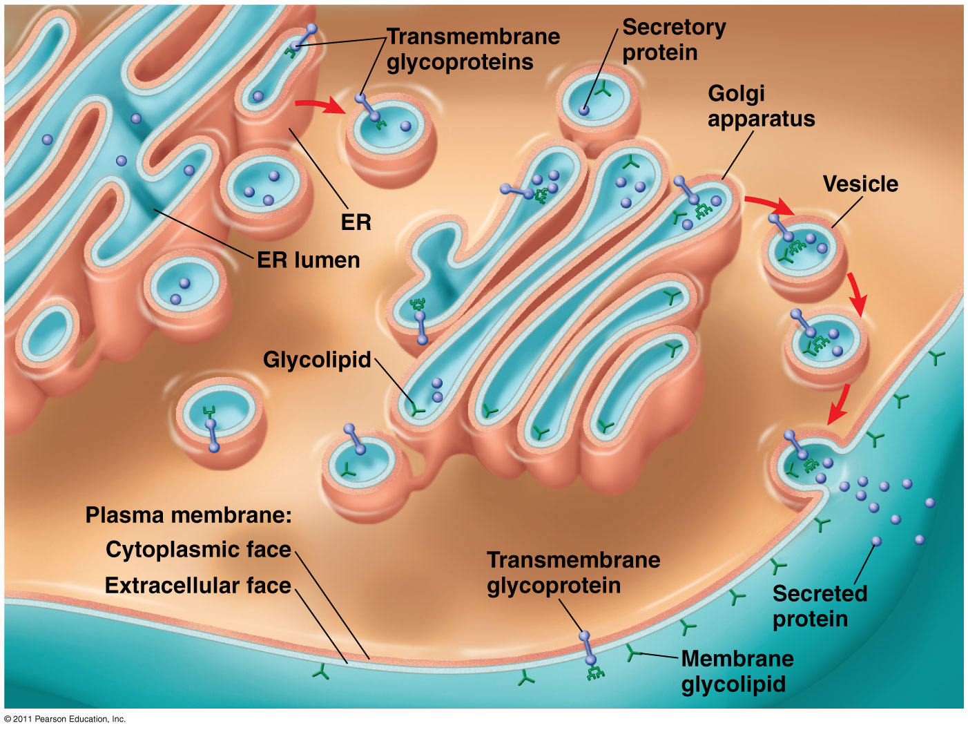
Synthesis and sidedness of membranes

Slide 16
Selective Permeability
Small molecules (polar or nonpolar) cross easily (hydrocarbons, hydrophobic molecules, CO₂, O₂)
Hydrophobic core prevents passage of ions, large polar molecules

Slide 17
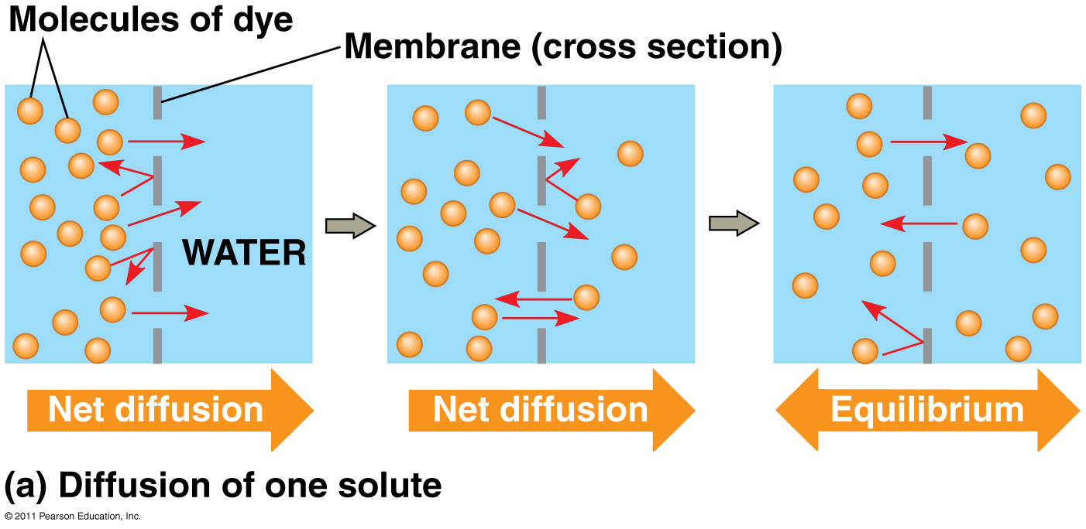
Passive Transport
NO ENERGY (ATP) needed!
Diffusion down concentration gradient (high → low concentration)
Eg. hydrocarbons, CO₂, O₂, H₂O

Slide 18
Diffusion

Slide 19
Osmosis: diffusion of H₂O

Slide 20
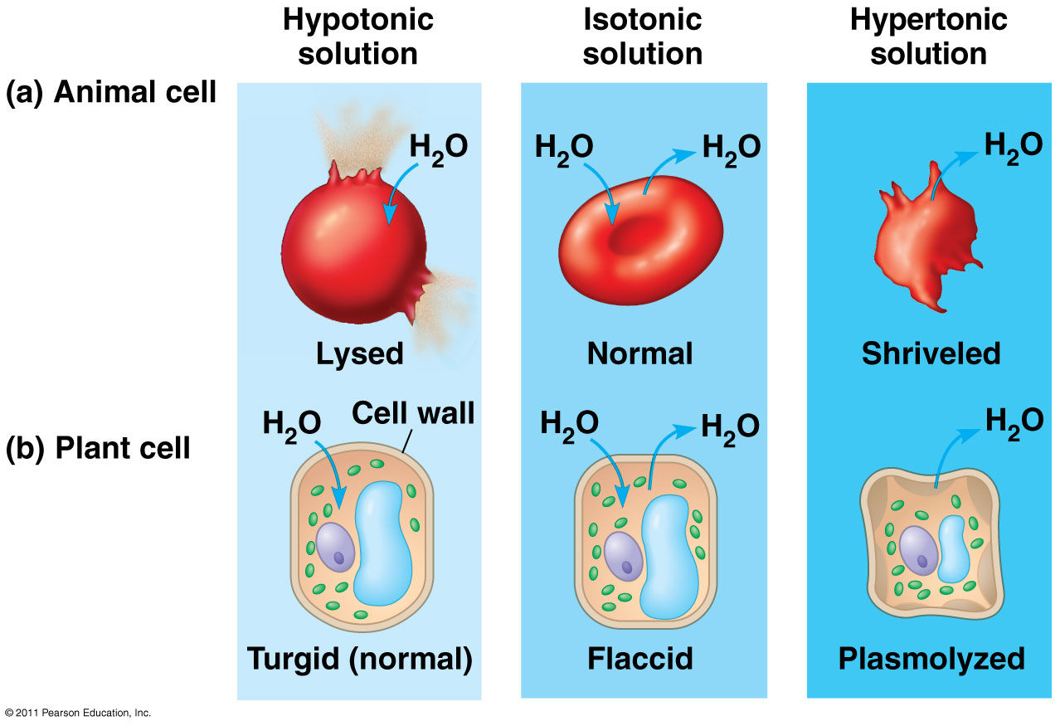
External environments can be hypotonic, isotonic or hypertonic to internal environments of cell

Slide 21
Understanding Water Potential

Slide 22
Water Potential
Water potential (ψ): H₂O moves from high ψ → low ψ potential
Water potential equation:
ψ = ψ_{S} + ψ_{P}
Water potential (ψ) = free energy of water
Solute potential (ψ_{S}) = solute concentration (osmotic potential)
Pressure potential (ψ_{P}) = physical pressure on solution; turgor pressure (plants)
Pure water: ψ_{P} = 0 MPa
Plant cells: ψ_{P} = 1 MPa

Slide 23
Calculating Solute Potential (ψ_{S})
ψ_{S} = -iCRT
i = ionization constant (# particles made in water)
C = molar concentration
R = pressure constant (0.0831 liter bars/mole-K)
T = temperature in K (273 + ⁰C)
The addition of solute to water lowers the solute potential (more negative) and therefore decreases the water potential.

Slide 24
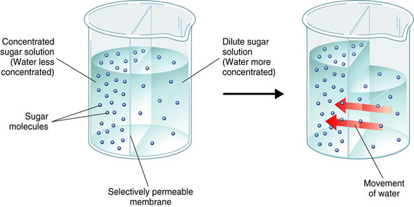
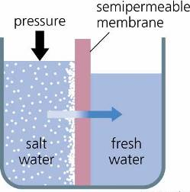
Where will WATER move?
From an area of:
higher ψ → lower ψ (more negative ψ)
low solute concentration → high solute concentration
high pressure → low pressure

Slide 25
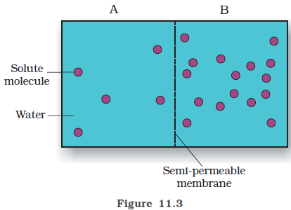
Which chamber has a lower water potential?
Which chamber has a lower solute potential?
In which direction will osmosis occur?
If one chamber has a Ψ of -2000 kPa, and the other -1000 kPa, which is the chamber that has the higher Ψ?

Slide 26
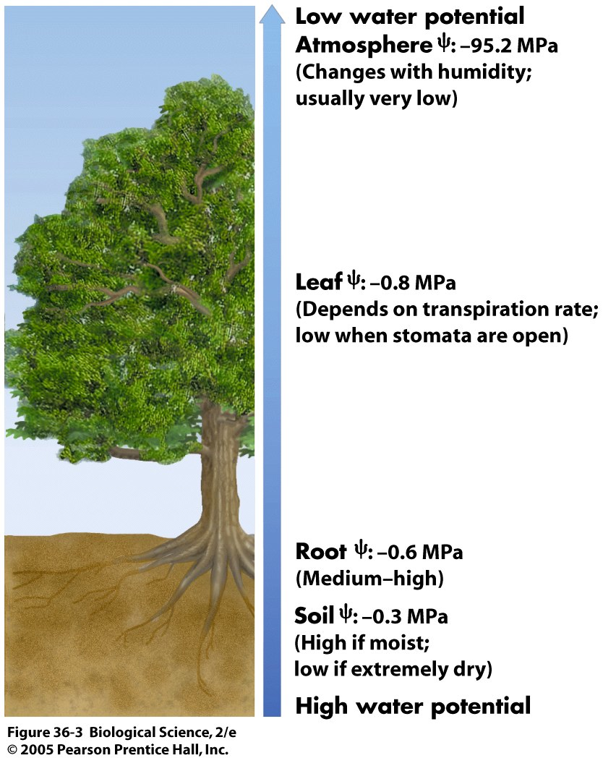

Slide 27
Sample Problem
Calculate the solute potential of a 0.1M NaCl solution at 25°C.
If the concentration of NaCl inside the plant cell is 0.15M, which way will the water diffuse if the cell is placed in the 0.1M NaCl solution?

Slide 28
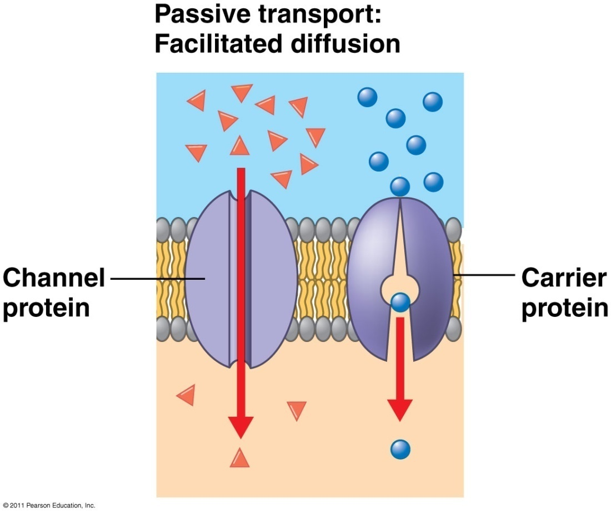
Facilitated Diffusion
Transport proteins (channel or carrier proteins) help hydrophilic substances cross
Two ways:
Provide hydrophilic channel
Loosely bind/carry molecule across
Eg. ions, polar molecules (H₂O, glucose)

Slide 29
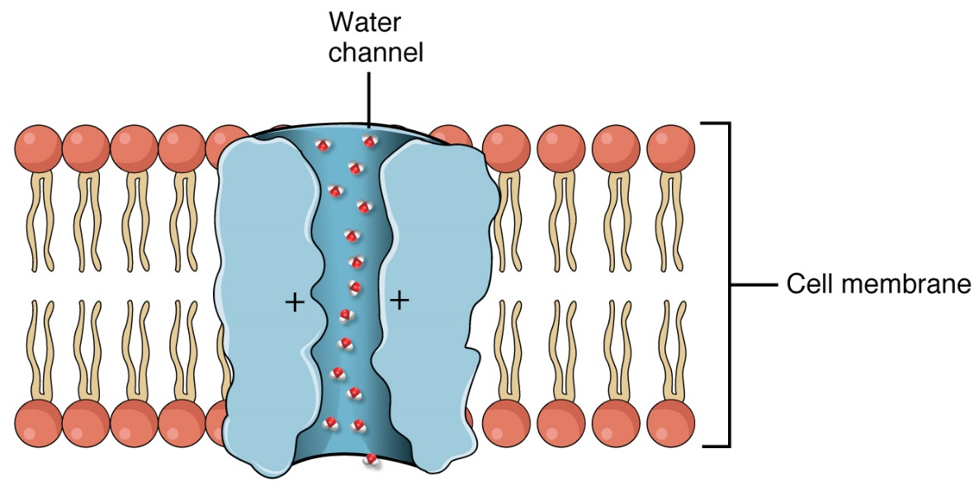
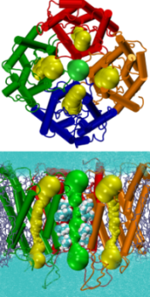
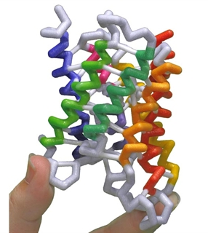
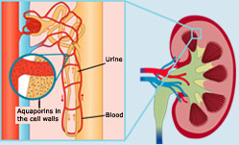
Aquaporin: channel protein that allows passage of H₂O

Slide 30
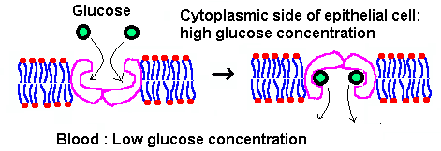
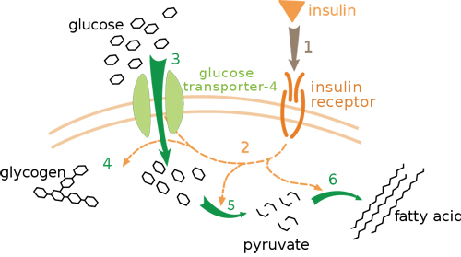
Glucose Transport Protein (carrier protein)

Slide 31
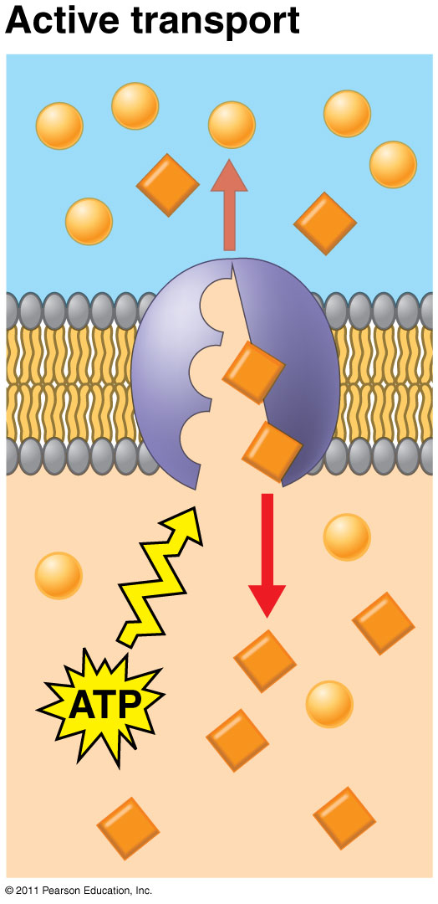
Active Transport
Requires ENERGY (ATP)
Proteins transport substances against concentration gradient (low → high conc.)
Eg. Na⁺/K⁺ pump, proton pump

Slide 32
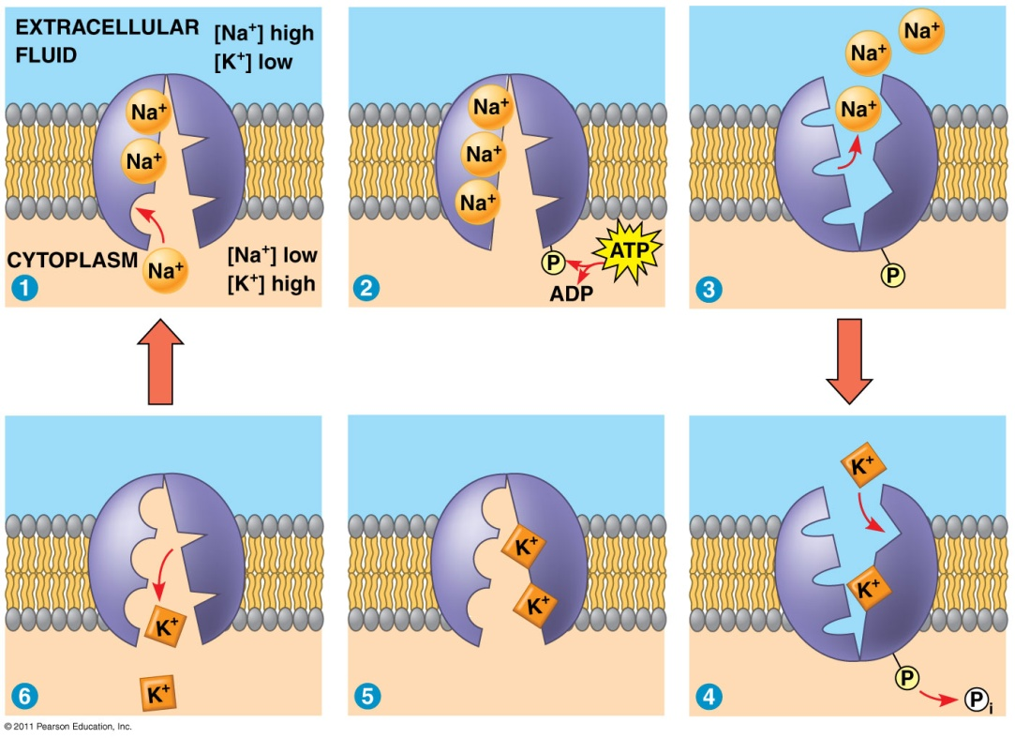
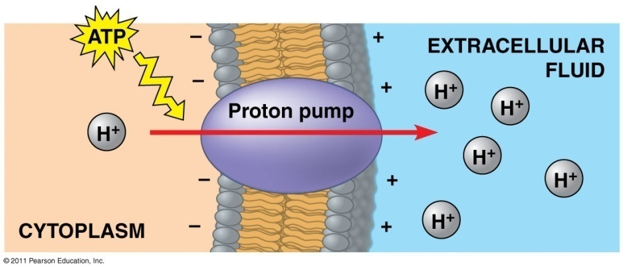
Electrogenic Pumps: generate voltage across membrane
Na⁺/K⁺ Pump
Proton Pump
Pump Na⁺ out, K⁺ into cell
Nerve transmission
Push protons (H⁺) across membrane
Eg. mitochondria (ATP production)

Slide 33
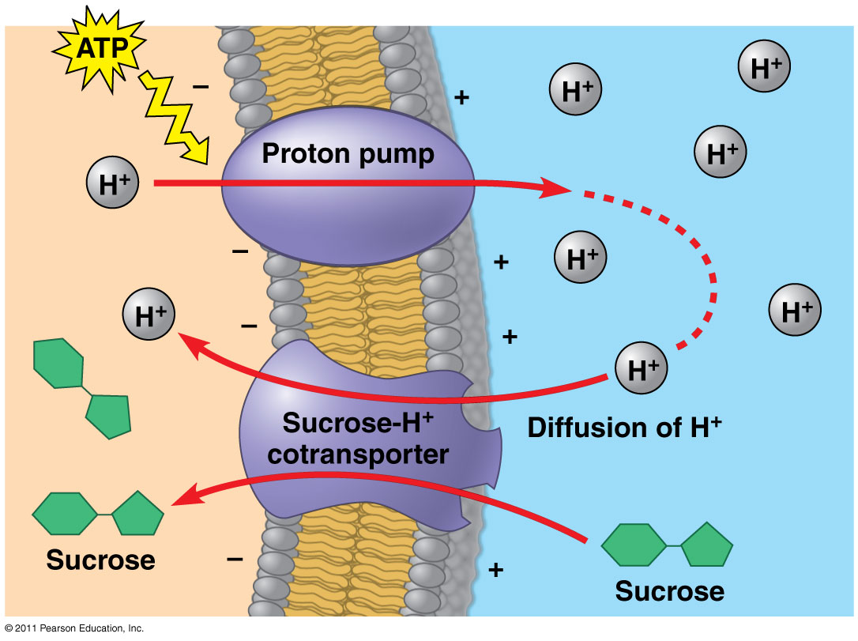
Cotransport: membrane protein enables “downhill” diffusion of one solute to drive “uphill” transport of other
Eg. sucrose-H⁺ cotransporter (sugar-loading in plants)

Slide 34
Passive vs. Active Transport
Little or no Energy
High → low concentrations
DOWN the concentration gradient
eg. diffusion, osmosis, facilitated diffusion (w/transport protein)
Requires Energy (ATP)
Low → high concentrations
AGAINST the concentration gradient
eg. pumps, exo/endocytosis

Slide 35
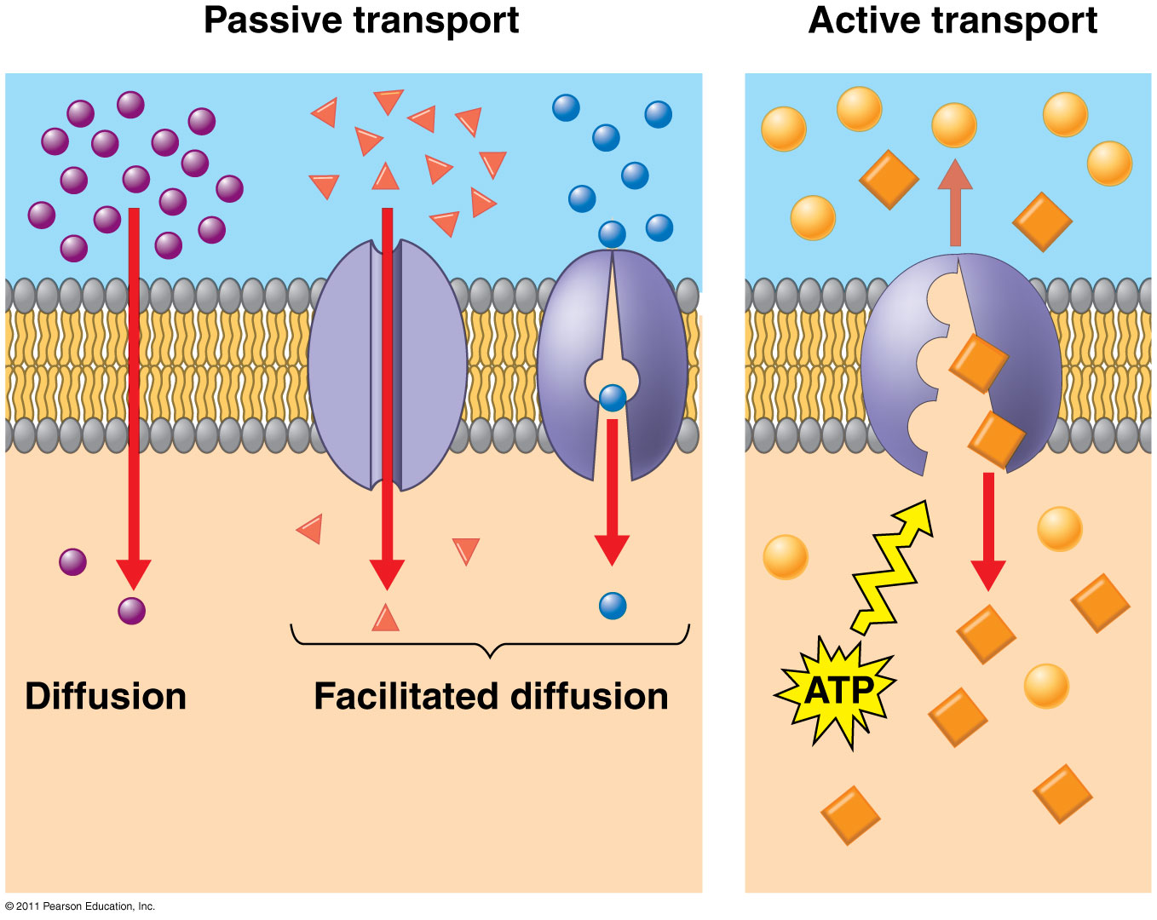

Slide 36
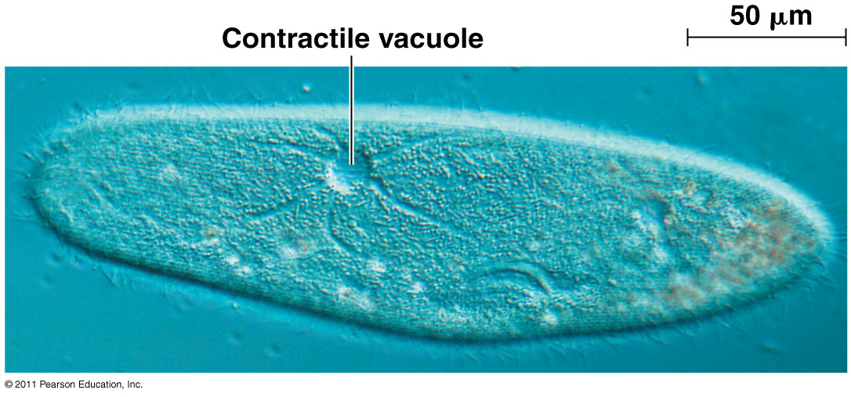
Osmoregulation
Control solute & water balance
Contractile vacuole: “bilge pump” forces out fresh water as it enters by osmosis
Eg. paramecium caudatum – freshwater protist

Slide 37
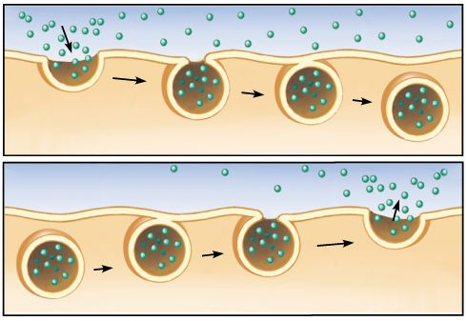
Bulk Transport
Transport of proteins, polysaccharides, large molecules
Endocytosis: take in macromolecules, form new vesicles
Exocytosis: vesicles fuse with cell membrane, expel contents

Slide 38
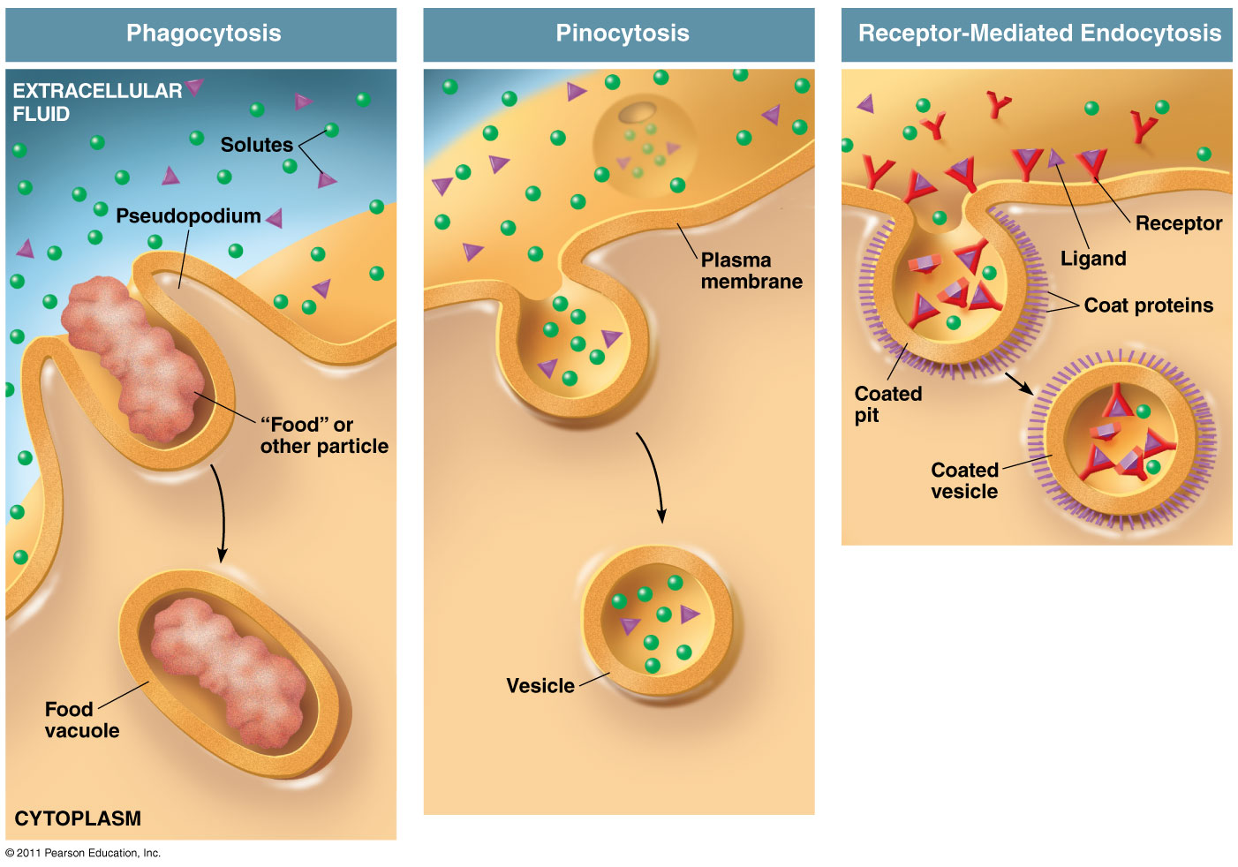
Types of Endocytosis
Phagocytosis:
“cellular eating” - solids
Pinocytosis:
“cellular drinking” - fluids
Receptor-Mediated Endocytosis:
Ligands bind to specific receptors on cell surface

