Slide 1
Photosynthesis

Slide 2
Photosynthesis
Is the process of capturing free energy in sunlight and storing that energy in chemical bonds, specially glucose.
The general chemical equation describing photosynthesis is:
6CO₂ + 6H₂O+light C₆H₁₂O₆+6O₂

Slide 3
Process of Photosynthesis
Begins with light-absorbing pigment in chloroplasts of plant cells
A pigment molecule is able to absorb the energy from light only within a narrow range of wavelengths.
The dominant light absorbing pigment is the green chlorophyll a, while other accessory pigments include other chlorophylls and various red, orange, and yellow carotenoids.
These pigments complement each other to maximize energy absorptions across the sunlight spectrum

Slide 4
Process of Photosynthesis
When light is absorbed by one of the pigments, the energy from the light is incorporated into electrons within the atoms that make up the molecules.
These energized electrons (or excited electrons) are unstable and almost immediately re-emit the absorbed energy.
The energy is then reabsorbed by electrons of a nearby pigment molecule
The process of energy absorption, followed by energy re-emission, continues with the energy bouncing from one pigment molecule to another

Slide 5
Process of Photosynthesis
The process ends when the energy is absorbed by one of two special chlorophyll a molecules, P₆₈₀ and P₇₀₀.
These two chlorophyll molecules, named with numbers that represent the wavelengths at which they absorb their maximum amounts of light (680 and 700 nanometers, respectively), are different from other chlorophyll molecules because of their association with various nearby pigments.
Together with these other pigments, chlorophyll P₇₀₀ forms a pigment cluster called photosystem I (PS I).
Chlorophyll P₆₈₀ forms photosystems II (PSII).

Slide 6
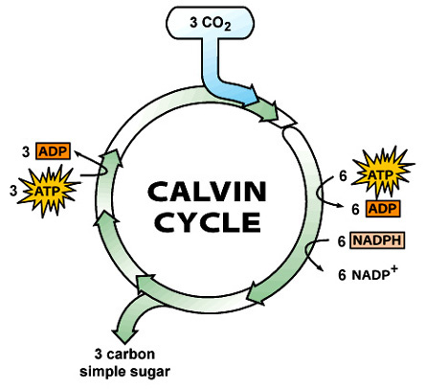
Photosynthesis includes the following processes:
Noncyclic photophosphorylation and cyclic photophosphorylation use H₂O and the energy in sunlight to generate ATP, NADPH, and O₂
The Calvin Cycle uses CO₂ and the energy in ATP and NADPH to make glucose.

Slide 7
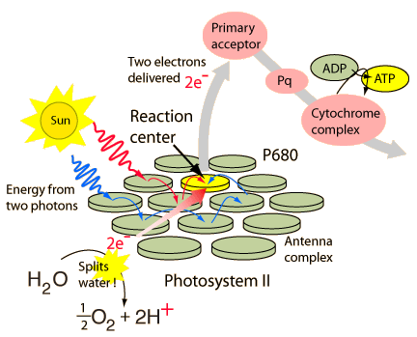
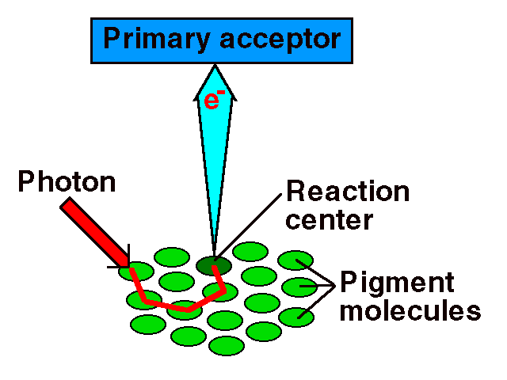
Noncyclic Photophosphorylation-is the process of using energy derived form light (photo) to generate ATP from adenosine diphosphate (ADP) and P_{i} (phosphorylation). Noncyclic photophosphorylation begins with PS II and follows these seven steps:
1. Photosystem II-Electrons trapped by P680 in photosystem II are energized by light.
2. Primary electron acceptor-Two energized electrons are passed to a molecule called the primary electron acceptor. This electron acceptor is called “primary” because it is the first in a chain of electron acceptors

Slide 8
Noncyclic Photophosphorylation- Electron Transport Chain
3. Electron transport chain-Electrons pass through an electron transport chain (ETC).
This chain consists of proteins in the thylakoid membrane of the chloroplast that pass electrons from one carrier protein to the next.
Some carrier proteins, such as the cytochromes, include non-protein parts containing iron
The electron transport chains in photosynthesis are analogous to those in the inner mitochondrial membrane in oxidative phosphorylataion

Slide 9
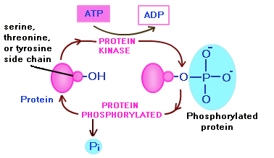
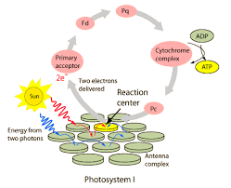
Noncyclic Photophosphorylation
4. Phosphorylation-as the two electrons move “down” the electron transport chain, they lose energy. The energy lost by the electrons as they pass along the electron transport chain is used to phosphorylate, on average, about 1.5 ATP molecules
5. Photosystem I-The electron transport chain terminates with PS I (with P700). Here the electrons are again energized by sunlight and passed to a primary electron acceptor (different from the one associated with PS II)

Slide 10
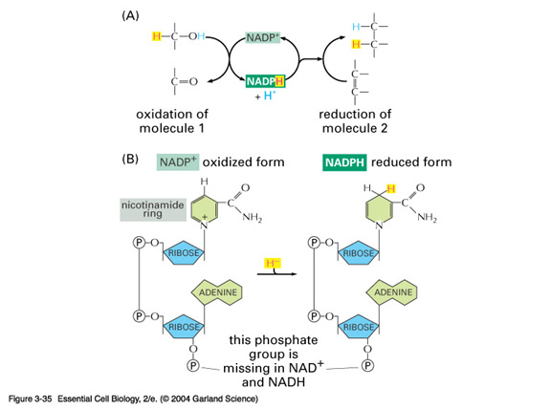
Noncyclic Photophosphorylation
6. NADPH-The two electrons pass through a short electron transport chain.
At the end of the chain, the two electrons combine with NADP⁺ and H⁺ to form NADPH.
Like NADH in respiration, NADPH is a coenzyme, electron acceptor, and forms an energy-rich molecule. (you can keep the two coenzymes NADH and NADPH associated with the correct processes by using the P in NADPH as a reminder of the P in photosynthesis.
The P in NADPH, however, actually represents phosphorus)

Slide 11
Noncyclic Photophosphorylation
7. Splitting of Water-The two electrons that originated in PS II are now incorporated into NADPH.
The loss of these two electrons from PSII is replaced when H₂O is split into two electrons 2H⁺ and ½ O₂
The two electrons from H₂O replace the lost electrons from PSII, one of the H⁺ provides the H in NADPH, and the ½ O₂ contributes to the oxygen gas that is released.

Slide 12
Noncyclic Photophosphorylation
In summary, photophosphorylation take the energy in light and the electrons in H2O to make the energy-rich molecules ATP and NADPH.
Because the reactions require light, they are often called the Light dependent reaction or, simply, light reactions.
The following equation informally summarizes the process
H₂O + ADP + P + NADP⁺ + light ATP + NADPH + O₂ + H₂

Slide 13
Cyclic Photophosphorylation
A second photophosphorylation sequence occurs when the electrons energized in PS I are “recycled”
In this sequence, energized electrons from PS I join with protein carriers and generate ATP as they pass along the electron transport chain
In contrast to noncyclic photophosphorylation, where electrons become incorporated into NADPH, electrons in cyclic photophosphorylation return to PSI
Here they can be energized again to participate in cyclic or noncyclic photophosphorylation.
Cyclic photophosphorylation occurs simultaneously with noncyclic photophosphorylation to generate additional ATP
Two electrons passing through cyclic photophosphorylation generate, on average, about 1 ATP

Slide 14
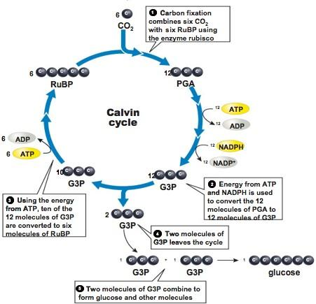
Calvin Cycle
The Calvin cycle “fixes” CO₂. That is, it takes chemically unreactive, inorganic CO₂, and incorporates it into an organic molecule that can be used in biological systems.
The biosynthetic pathway produces a single molecule of glucose (C₆H₁₂O₆), in order to accomplish this.
The Calvin cycle must repeat six times, and use 6 CO₂ molecules
All molecules involved have been multiplied by 6

Slide 15
Calvin Cycle process
1. Carbon fixation: 6 CO2 combine with 6RuBP to produce 12 PGA
The enzyme rubisco catalyzes the merging of CO₂ and RuBP
The Calvin cycle is referred to as C₃ photosynthesis because the first product formed, PGA, contains three carbon atoms

Slide 16
Calvin Cycle process
2. Reduction: 12 ATP and 12 NADPH are used to convert 12 PGA to 12 G3P
The energy in the ATP and NADPH molecules is incorporated in G3P, thus making G3P a very energy –rich molecule.
ADP, P_{i} and NADP⁺ are released and then re-energized in noncyclic photophosphorylation

Slide 17
Calvin Cycle process
3. Regeneration: 6 ATP are used to convert 10 G3P to 6RuBP.
Regenerating the 6 RuBP originally used to combine with 6 CO2 allows the cycle to repeat.

Slide 18
Calvin Cycle process
Carbohydrate synthesis-Note that 12 G3P were created in step 2, but only 10 were used in step 3.
What happened to the remaining 2?
These two remaining G3P are used to build glucose.
Other monosaccharides, like fructose and maltose, can also be formed
In addition, glucose molecules can be combined to form disaccharides, like sucrose, and polysaccharides, like starch and cellulose.

Slide 19
Light-Independent Reactions
You should recognize that no light is directly used in the Calvin cycle.
These reactions are often called the light-independent reactions or even the dark reactions
But be careful, the Calvin cycle occurs in the presence of light
This is because it is dependent upon the energy from ATP and NADPH, and these two energy-rich molecules can be created only during photophosphorylation, which can occur only in light.

Slide 20
Calvin Cycle
In summary, the Calvin cycle takes CO2 from the atmosphere and the energy in ATP and NADPH to create a glucose molecule
Of course, the energy in ATP and NADPH represents energy from the sun captured during photophosphorylation
The Calvin Cycle can be informally summarized as follows:
6CO₂ + 18 ATP + 12 NADPH 18 ADP + 12 NADP⁺ + 1 glucose

Slide 21
Chloroplast-are the site where both the light dependant and light-independent reactions of photosynthesis occur. Chloroplast consist of the following areas
Outer membrane-This membrane, like the plasma membrane, consists of a double layer of phospholipids
Intermembrane space-This is the narrow area between the inner and outer membranes
Inner membrane-This second membrane is also a double phospholipid bilayer
Stromata-The stromata is the fluid material that fills the area inside the inner membrane. The Calvin cycle occurs here, fixing carbon from CO₂ to generate G3P, the precursor to glucose
Thylakoids-Suspended within the stromata are stacks of pancake-like membranes. Individual membrane layers (the “pancakes”) are thylakoids; an entire stack of thylakoids is a granum (plural grana). The membranes of the thylakoid contain the protein complexes (including photosystems PS I and PS II), cytochromes, and other electron carriers of the light–dependent reactions
Thylakoid Lumen-This is the inside, or lumen, of the thylakoid; H⁺ ions (protons) accumulate here

