Slide 1
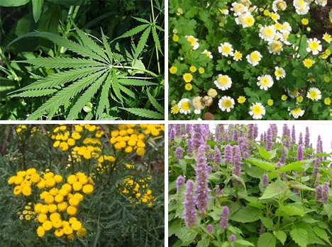
Kingdom Plantae
Transport

Slide 2
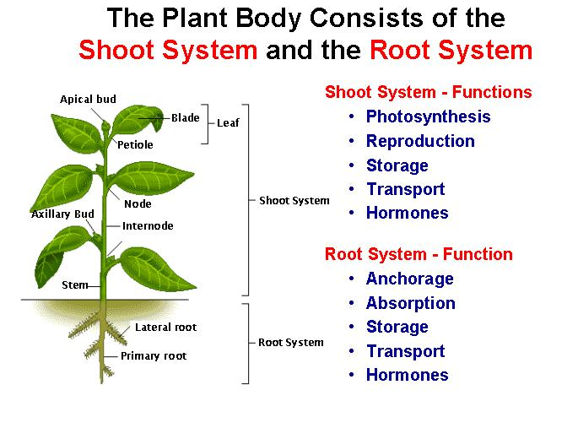

Slide 3
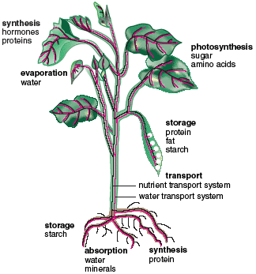
How Does…
Water and dissolved nutrients get upwards from the root?
Carbohydrates produced in leaves get to the rest of plant?

Slide 4
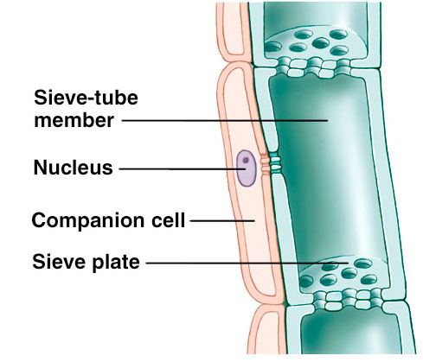
How do plants transport carbohydrates?
Movement of carbohydrates through vascular system is called translocation
Carbohydrates produced in photosynthetic organs (usually leaves) and often stored in roots
Movement of carbohydrates is through phloem
Phloem consists of two types of cells:
Sieve cells: living cells stacked on top of each other
Sieve-tube members: similar to sieve cells but found only in angiosperms (flowering plants)

Slide 5
How do plants transport carbohydrates?
Mass-flow or pressure-flow hypothesis:
Carbohydrates move from source (site produced or stored) to sink (site used)
Carbohydrates actively transported into phloem at source
High concentration of carbohydrates causes greater osmotic pressure in phloem; water moves in from adjacent xylem by osmosis
Water influx creates (turgor) pressure inside phloem; pushing water and dissolved carbohydrates through phloem
At sink, carbohydrates actively removed from phloem; reducing osmotic pressure in phloem
water leaves phloem and reenters xylem, maintaining a osmotic pressure gradient between sources and sinks

Slide 6
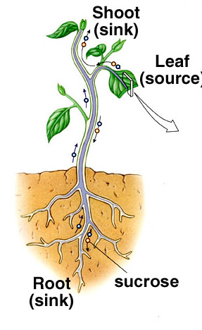
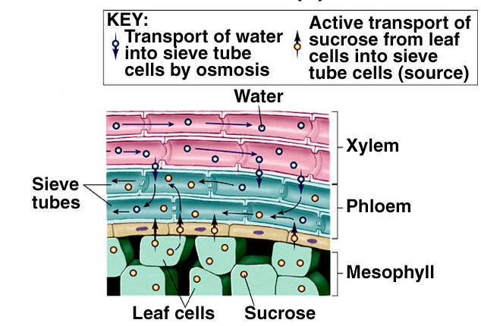
How do plants transport carbohydrates?
Mass-flow or pressure-flow hypothesis:

Slide 7
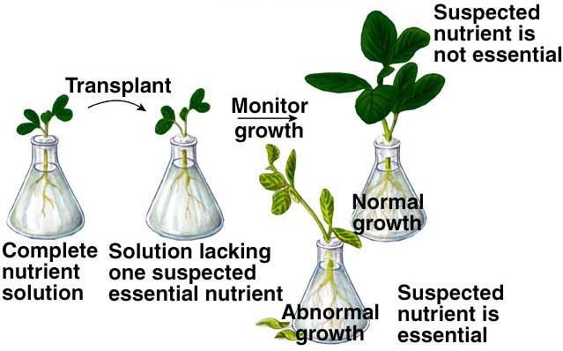
Nutrients required by plants
Macronutrients (required in relatively large amounts)
9 macronutrients including:
Nitrogen
Fertilizer numbers (e.g.10-15-10) refer to these macronutrients
Phosphorus
Potassium
Micronutrients (required in trace amounts)
7 micronutrients including:
Chlorine
Iron
Manganese

Slide 8
Nutrients required by plants
Most nutrients needed by plants obtained from soil
Most roots found in topsoil
Mineral particles (nutrients)
Living organisms (particularly detritivores)
Humus (partly decayed organic matter)
Some plants in acidic bogs obtain Nitrogen by trapping and digesting insects (e.g. Venus flytrap)
Legumes house Nitrogen-fixing bacteria in root nodules
Most plants have mycorrhizal fungi that enhance nutrient uptake by increasing surface area of ‘roots’

Slide 9
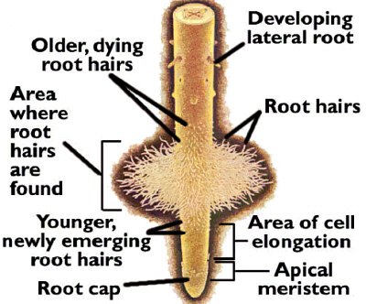
How do plants get nutrients and water into roots?
Water ‘absorbed’ by root hairs (projections of epidermis cells)
Root hairs greatly increase surface area over which to ‘absorb’ water
Root hairs have greater osmotic potential than soil
osmotic (or solute) potential = pressure that must be applied to stop osmosis
Root cells actively pump ions (use ATP) into cells
High concentration of ions creates a greater osmotic pressure in plant than surrounding soil water; water moves into cells by osmosis

Slide 10
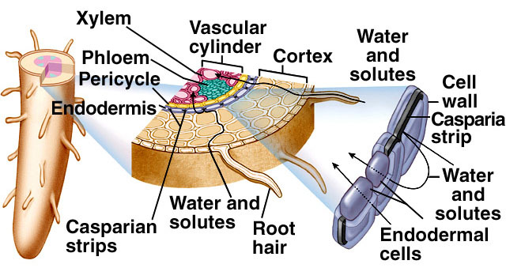
How do plants get nutrients and water into vascular system of roots?
Water and ions enter root hairs and move between or through membranes of cells of cortex
Casparian strips block water movement; force water through cell membranes of endoderm
Endodermal cells selects nutrients that enter vascular tissue (xylem)

Slide 11
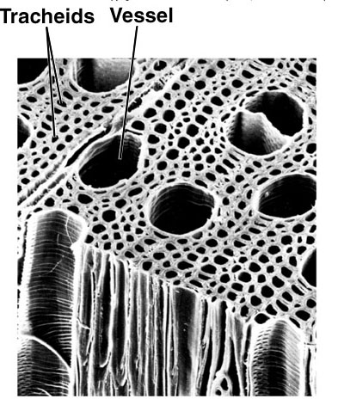
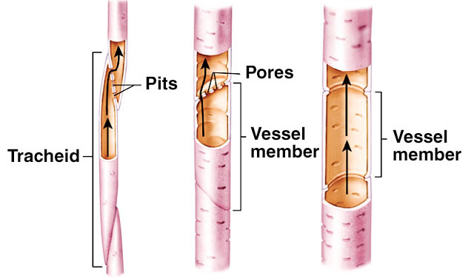
How do plants get nutrients and water up xylem?
Xylem includes 2 types of dead, hollow, tubular cells
Vessel members: slightly large diameter; cells stacked
Tracheids: smaller diameter; side to side overlap
Vessel members only occur in angiosperms (flowering plants)

Slide 12
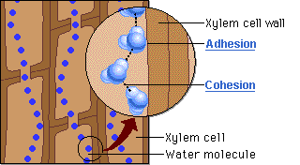
How do plants get nutrients and water up xylem?
Water molecules sticks to walls of xylem (adhesion) and to each other (cohesion)
Water moves through xylem in unbroken column
Air on leaf surfaces causes water to evaporate, creating a ‘pull’ on the water column
Essentially, osmotic pressure of air is greater than osmotic pressure within leaves
Process of evaporative water loss in plants is called transpiration

Slide 13
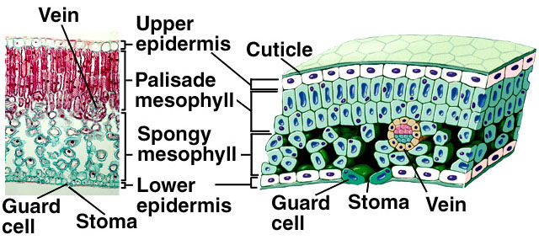
Transpiration
90% of water ‘absorbed’ by roots lost through transpiration in leaves
Transpiration through stomata, pores in epidermis of leaves
Transpiration rate regulated by two guard cells surrounding each stoma (or stomate)

Slide 14
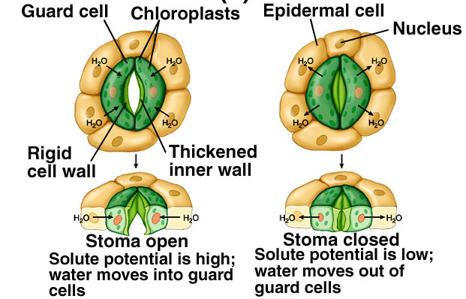
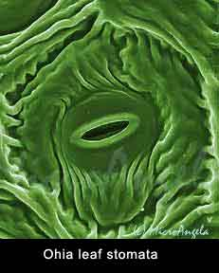
Transpiration
Action of guard cells
Guard cells open when water moves into cells by osmosis (i.e. cells are turgid)
Turgor results from active uptake of Potassium (K⁺) ions; and subsequent influx of water by osmosis

